Slide 1
Skinker DeBaliviere, DeBaliviere Place, West End, Visitation Park
Monthly Crime report: December 2019 Washington University Medical Center

Slide 2
Skinker DeBaliviere: Summary Notes
14 total crimes in December 2019
-7% change compared to December 2018 (15 total crimes)
1 crime(s) against persons in December 2019
0% change compared to December 2018 (1 crimes against persons)
264 total crimes in 2019
23% change compared to this time in 2018 (215 total crimes)
42 crime(s) against persons in 2019
-9% change compared to this time in 2018 (46 crimes against persons)

Slide 3
Skinker DeBaliviere: Year to Year Comparison
Part 1 Crimes | Jan | Feb | Mar | Apr | May | Jun | Jul | Aug | Sep | Oct | Nov | Dec | Total
Aggravated Assault | 6 | 1 | 1 | 0 | 6 | 1 | 2 | 5 | 1 | 2 | 1 | 1 | 27
Arson | 0 | 0 | 0 | 0 | 0 | 0 | 0 | 0 | 0 | 0 | 0 | 0 | 0
Burgalry | 2 | 0 | 1 | 0 | 2 | 5 | 2 | 3 | 3 | 1 | 1 | 0 | 20
Homicide | 0 | 0 | 0 | 0 | 0 | 0 | 0 | 0 | 0 | 0 | 0 | 0 | 0
Larceny | 10 | 7 | 8 | 7 | 6 | 10 | 9 | 13 | 14 | 12 | 13 | 13 | 122
Motor Vehicle Theft | 1 | 1 | 3 | 2 | 4 | 1 | 3 | 6 | 1 | 3 | 1 | 1 | 27
Robbery | 0 | 3 | 1 | 2 | 0 | 2 | 2 | 1 | 7 | 0 | 1 | 0 | 19
Total | 19 | 12 | 14 | 11 | 18 | 19 | 18 | 28 | 26 | 18 | 17 | 15 | 215
Part 1 Crimes | Jan | Feb | Mar | Apr | May | Jun | Jul | Aug | Sep | Oct | Nov | Dec | Total
Aggravated Assault | 0 | 0 | 7 | 0 | 6 | 1 | 0 | 1 | 0 | 0 | 2 | 1 | 18
Arson | 0 | 0 | 0 | 0 | 0 | 0 | 0 | 0 | 0 | 0 | 0 | 0 | 0
Burgalry | 4 | 9 | 0 | 1 | 4 | 6 | 5 | 2 | 4 | 2 | 1 | 1 | 39
Homicide | 0 | 0 | 0 | 0 | 0 | 0 | 0 | 0 | 0 | 0 | 0 | 1 | 1
Larceny | 4 | 8 | 16 | 18 | 15 | 17 | 21 | 9 | 11 | 20 | 13 | 10 | 162
Motor Vehicle Theft | 1 | 3 | 0 | 0 | 2 | 1 | 1 | 4 | 1 | 2 | 4 | 1 | 20
Robbery | 1 | 1 | 0 | 2 | 4 | 5 | 1 | 2 | 4 | 1 | 3 | 0 | 24
Total | 10 | 21 | 23 | 21 | 31 | 30 | 28 | 18 | 20 | 25 | 23 | 14 | 264

Slide 4
Skinker DeBaliviere: Summary Tables
Part 1 Crimes | Number of Crimes
Aggravated Assault | 1
Burgalry | 1
Homicide | 1
Larceny | 10
Motor Vehicle Theft | 1
Total | 14
Day of the Week | Number of Crimes
Sun | 4
Mon | 1
Tue | 2
Wed | 2
Thu | 2
Fri | 1
Sat | 2
Total | 14
Crimes Against Persons | Number of Crimes
FALSE | 12
TRUE | 2
Total | 14
Time of Day | Number of Crimes
Day | 12
Night | 2
Total | 14

Slide 5
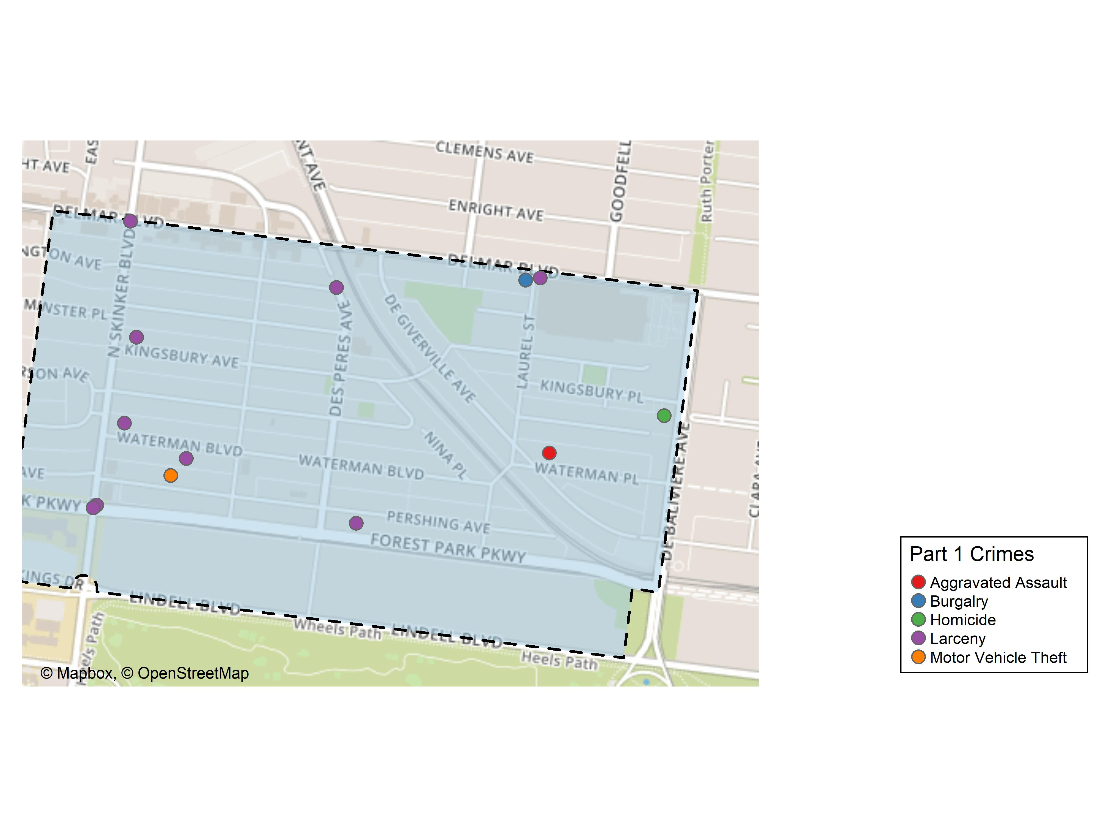
Skinker DeBaliviere: Total Crime Map

Slide 6
DeBaliviere Place: Summary Notes
14 total crimes in December 2019
40% change compared to December 2018 (10 total crimes)
1 crime(s) against persons in December 2019
-50% change compared to December 2018 (2 crimes against persons)
165 total crimes in 2019
-10% change compared to this time in 2018 (183 total crimes)
23 crime(s) against persons in 2019
-28% change compared to this time in 2018 (32 crimes against persons)

Slide 7
DeBaliviere Place: Year to Year Comparison
Part 1 Crimes | Jan | Feb | Mar | Apr | May | Jun | Jul | Aug | Sep | Oct | Nov | Dec | Total
Aggravated Assault | 1 | 0 | 1 | 0 | 0 | 1 | 2 | 0 | 0 | 3 | 3 | 0 | 11
Arson | 0 | 0 | 0 | 0 | 0 | 0 | 0 | 0 | 0 | 0 | 0 | 0 | 0
Burgalry | 0 | 0 | 0 | 0 | 1 | 2 | 0 | 1 | 1 | 2 | 1 | 0 | 8
Homicide | 0 | 0 | 0 | 0 | 0 | 0 | 0 | 0 | 0 | 0 | 0 | 0 | 0
Larceny | 22 | 6 | 7 | 5 | 7 | 12 | 16 | 11 | 9 | 13 | 9 | 8 | 125
Motor Vehicle Theft | 6 | 0 | 1 | 3 | 3 | 0 | 2 | 1 | 0 | 1 | 1 | 0 | 18
Robbery | 3 | 1 | 0 | 2 | 1 | 4 | 0 | 2 | 1 | 0 | 5 | 2 | 21
Total | 32 | 7 | 9 | 10 | 12 | 19 | 20 | 15 | 11 | 19 | 19 | 10 | 183
Part 1 Crimes | Jan | Feb | Mar | Apr | May | Jun | Jul | Aug | Sep | Oct | Nov | Dec | Total
Aggravated Assault | 0 | 0 | 0 | 0 | 0 | 2 | 3 | 0 | 5 | 1 | 1 | 1 | 13
Arson | 0 | 0 | 0 | 0 | 0 | 0 | 0 | 0 | 0 | 0 | 0 | 0 | 0
Burgalry | 1 | 0 | 1 | 1 | 2 | 0 | 0 | 2 | 2 | 3 | 0 | 0 | 12
Homicide | 0 | 0 | 0 | 0 | 0 | 0 | 0 | 0 | 0 | 0 | 0 | 0 | 0
Larceny | 8 | 8 | 0 | 4 | 2 | 6 | 10 | 8 | 21 | 8 | 18 | 13 | 106
Motor Vehicle Theft | 0 | 1 | 1 | 2 | 0 | 2 | 3 | 1 | 4 | 7 | 3 | 0 | 24
Robbery | 2 | 2 | 0 | 1 | 0 | 0 | 3 | 0 | 1 | 0 | 1 | 0 | 10
Total | 11 | 11 | 2 | 8 | 4 | 10 | 19 | 11 | 33 | 19 | 23 | 14 | 165

Slide 8
DeBaliviere Place: Summary Tables
Part 1 Crimes | Number of Crimes
Aggravated Assault | 1
Larceny | 13
Total | 14
Day of the Week | Number of Crimes
Sun | 2
Mon | 5
Tue | 1
Wed | 3
Thu | 2
Fri | 1
Sat | 0
Total | 14
Crimes Against Persons | Number of Crimes
FALSE | 13
TRUE | 1
Total | 14
Time of Day | Number of Crimes
Day | 13
Night | 1
Total | 14

Slide 9
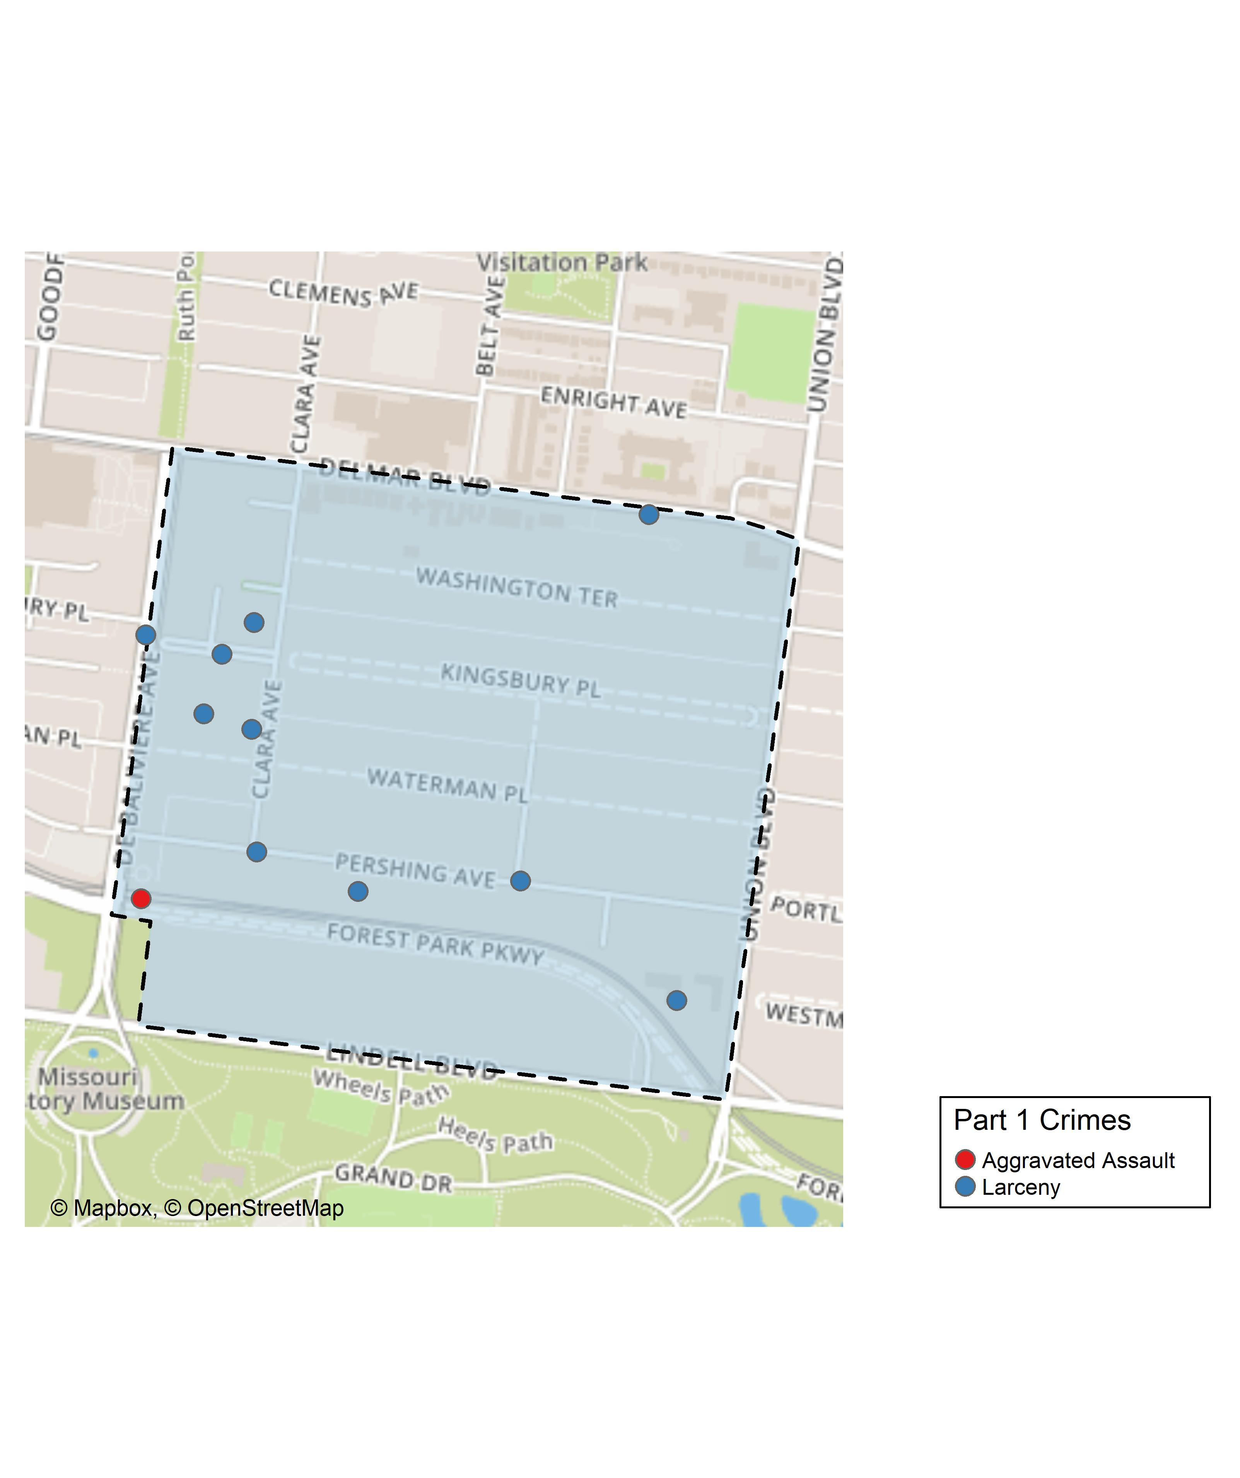
DeBaliviere Place: Total Crime Map

Slide 10
Summary Notes: West End
32 total crimes in December 2019
10% change compared to December 2018 (29 total crimes)
13 crime(s) against persons in December 2019
225% change compared to December 2018 (4 crimes against persons)
441 total crimes in 2019
-2% change compared to this time in 2018 (449 total crimes)
150 crime(s) against persons in 2019
26% change compared to this time in 2018 (119 crimes against persons)

Slide 11
West End: Year to Year Comparison
Part 1 Crimes | Jan | Feb | Mar | Apr | May | Jun | Jul | Aug | Sep | Oct | Nov | Dec | Total
Aggravated Assault | 5 | 0 | 9 | 7 | 13 | 6 | 8 | 9 | 11 | 10 | 2 | 0 | 80
Arson | 0 | 0 | 0 | 0 | 0 | 0 | 1 | 0 | 0 | 0 | 0 | 0 | 1
Burgalry | 5 | 2 | 2 | 4 | 6 | 7 | 5 | 6 | 4 | 5 | 5 | 7 | 58
Homicide | 0 | 0 | 1 | 0 | 0 | 0 | 0 | 0 | 0 | 1 | 0 | 0 | 2
Larceny | 18 | 11 | 16 | 18 | 24 | 23 | 16 | 18 | 24 | 21 | 11 | 12 | 212
Motor Vehicle Theft | 7 | 3 | 1 | 5 | 6 | 4 | 3 | 6 | 4 | 5 | 7 | 6 | 57
Robbery | 4 | 0 | 4 | 5 | 4 | 3 | 3 | 3 | 3 | 3 | 3 | 4 | 39
Total | 39 | 16 | 33 | 39 | 53 | 43 | 36 | 42 | 46 | 45 | 28 | 29 | 449
Part 1 Crimes | Jan | Feb | Mar | Apr | May | Jun | Jul | Aug | Sep | Oct | Nov | Dec | Total
Aggravated Assault | 6 | 4 | 6 | 13 | 11 | 6 | 9 | 12 | 13 | 11 | 3 | 6 | 100
Arson | 0 | 0 | 0 | 0 | 0 | 0 | 1 | 0 | 1 | 1 | 0 | 0 | 3
Burgalry | 4 | 4 | 5 | 7 | 5 | 4 | 1 | 6 | 6 | 0 | 0 | 4 | 46
Homicide | 0 | 0 | 0 | 0 | 0 | 0 | 1 | 0 | 1 | 0 | 0 | 1 | 3
Larceny | 7 | 13 | 11 | 19 | 12 | 19 | 20 | 22 | 21 | 15 | 17 | 7 | 183
Motor Vehicle Theft | 5 | 5 | 5 | 3 | 2 | 1 | 6 | 5 | 8 | 6 | 3 | 7 | 56
Robbery | 6 | 4 | 5 | 1 | 2 | 5 | 3 | 4 | 3 | 6 | 4 | 7 | 50
Total | 28 | 30 | 32 | 43 | 32 | 35 | 41 | 49 | 53 | 39 | 27 | 32 | 441

Slide 12
West End: Summary Tables
Part 1 Crimes | Number of Crimes
Aggravated Assault | 6
Burgalry | 4
Homicide | 1
Larceny | 7
Motor Vehicle Theft | 7
Robbery | 7
Total | 32
Day of the Week | Number of Crimes
Sun | 4
Mon | 6
Tue | 7
Wed | 8
Thu | 2
Fri | 2
Sat | 3
Total | 32
Crimes Against Persons | Number of Crimes
FALSE | 18
TRUE | 14
Total | 32
Time of Day | Number of Crimes
Day | 19
Night | 13
Total | 32

Slide 13
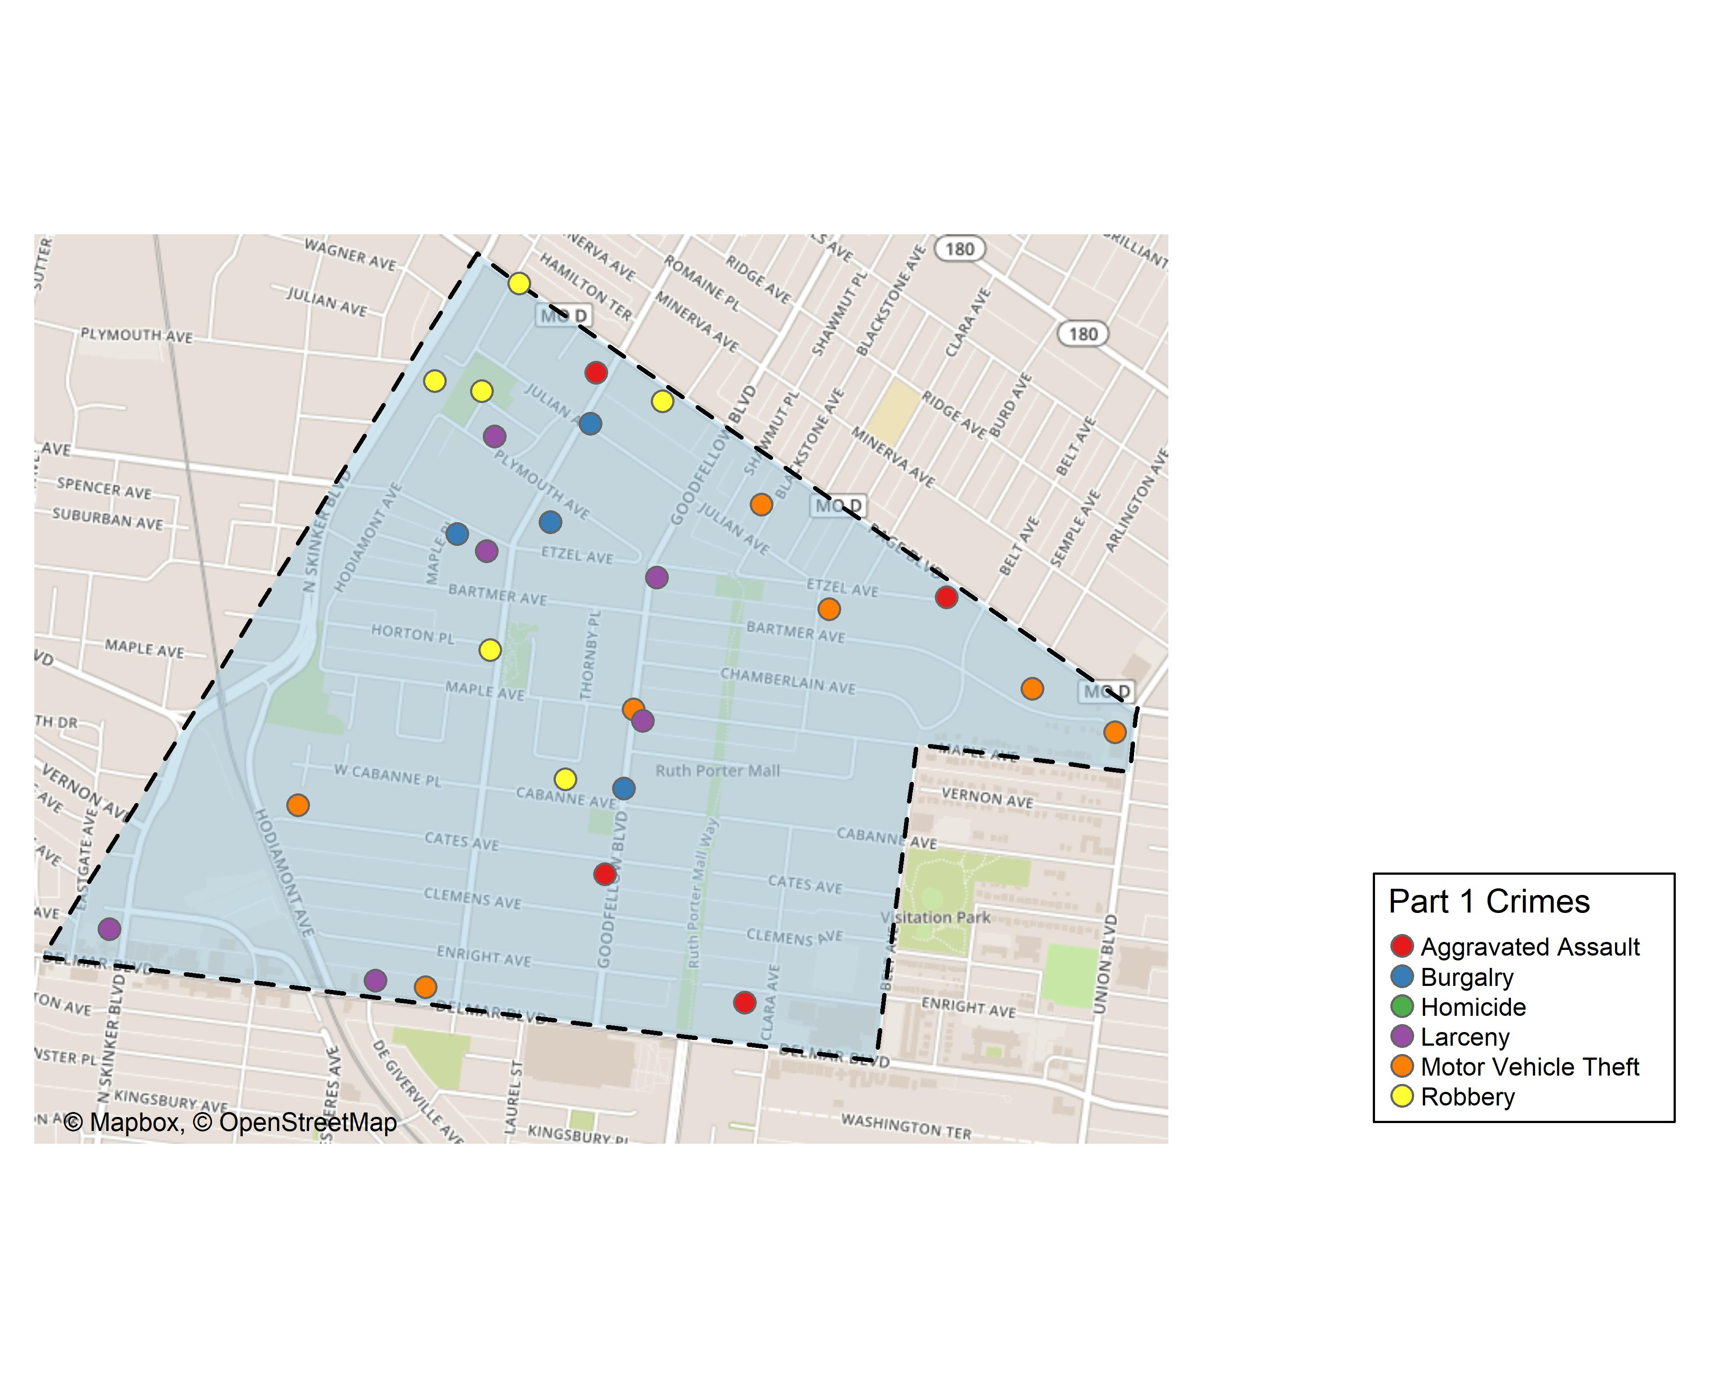
West End: Total Crime Map

Slide 14
Visitation Park: Summary Notes
5 total crimes in December 2019
67% change compared to December 2018 (3 total crimes)
2 crime(s) against persons in December 2019
Inf change compared to December 2018 (0 crimes against persons)
60 total crimes in 2019
-21% change compared to this time in 2018 (76 total crimes)
16 crime(s) against persons in 2019
-16% change compared to this time in 2018 (19 crimes against persons)

Slide 15
Visitation Park: Year to Year Comparison
Part 1 Crimes | Jan | Feb | Mar | Apr | May | Jun | Jul | Aug | Sep | Oct | Nov | Dec | Total
0 | 0 | 0 | 0 | 0 | 0 | 0 | 0 | 0 | 0 | 0 | 0 | 0 | 0
Aggravated Assault | 0 | 2 | 0 | 3 | 0 | 3 | 3 | 3 | 0 | 0 | 1 | 0 | 15
Arson | 0 | 0 | 0 | 0 | 0 | 0 | 0 | 0 | 0 | 0 | 1 | 0 | 1
Burgalry | 1 | 3 | 0 | 1 | 0 | 0 | 0 | 4 | 0 | 1 | 0 | 3 | 13
Homicide | 0 | 0 | 0 | 0 | 0 | 0 | 0 | 0 | 0 | 0 | 0 | 0 | 0
Larceny | 4 | 0 | 0 | 2 | 2 | 5 | 6 | 3 | 8 | 4 | 3 | 0 | 37
Motor Vehicle Theft | 0 | 0 | 0 | 1 | 2 | 1 | 1 | 0 | 0 | 1 | 0 | 0 | 6
Robbery | 0 | 1 | 0 | 0 | 0 | 0 | 0 | 0 | 1 | 2 | 0 | 0 | 4
Total | 5 | 6 | 0 | 7 | 4 | 9 | 10 | 10 | 9 | 8 | 5 | 3 | 76
Part 1 Crimes | Jan | Feb | Mar | Apr | May | Jun | Jul | Aug | Sep | Oct | Nov | Dec | Total
Aggravated Assault | 1 | 0 | 3 | 0 | 0 | 0 | 1 | 1 | 4 | 1 | 0 | 1 | 12
Arson | 0 | 0 | 0 | 0 | 0 | 0 | 0 | 0 | 0 | 0 | 0 | 0 | 0
Burgalry | 0 | 1 | 2 | 1 | 2 | 0 | 0 | 0 | 0 | 0 | 1 | 0 | 7
Homicide | 0 | 0 | 0 | 0 | 1 | 0 | 0 | 0 | 0 | 0 | 0 | 0 | 1
Larceny | 2 | 1 | 1 | 0 | 0 | 1 | 2 | 8 | 2 | 7 | 2 | 3 | 29
Motor Vehicle Theft | 1 | 1 | 0 | 1 | 1 | 0 | 0 | 0 | 1 | 0 | 2 | 0 | 7
Robbery | 2 | 0 | 0 | 0 | 0 | 0 | 0 | 0 | 0 | 1 | 0 | 1 | 4
Total | 6 | 3 | 6 | 2 | 4 | 1 | 3 | 9 | 7 | 9 | 5 | 5 | 60

Slide 16
Visitation Park: Summary Tables
Part 1 Crimes | Number of Crimes
Aggravated Assault | 1
Larceny | 3
Robbery | 1
Total | 5
Day of the Week | Number of Crimes
Sun | 0
Mon | 0
Tue | 0
Wed | 0
Thu | 1
Fri | 1
Sat | 3
Total | 5
Crimes Against Persons | Number of Crimes
FALSE | 3
TRUE | 2
Total | 5
Time of Day | Number of Crimes
Day | 4
Night | 1
Total | 5

Slide 17
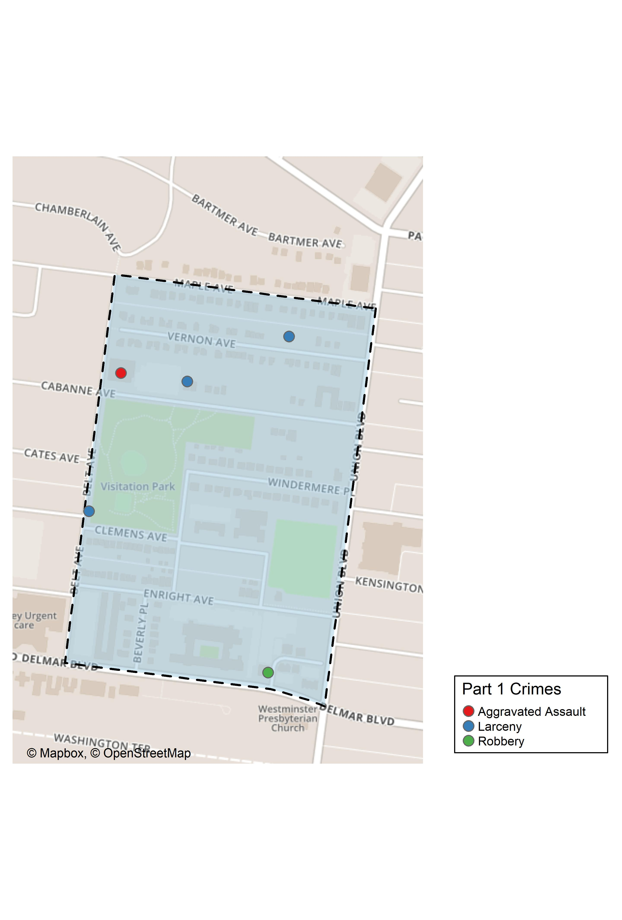
Visitation Park: Total Crime Map

Slide 18
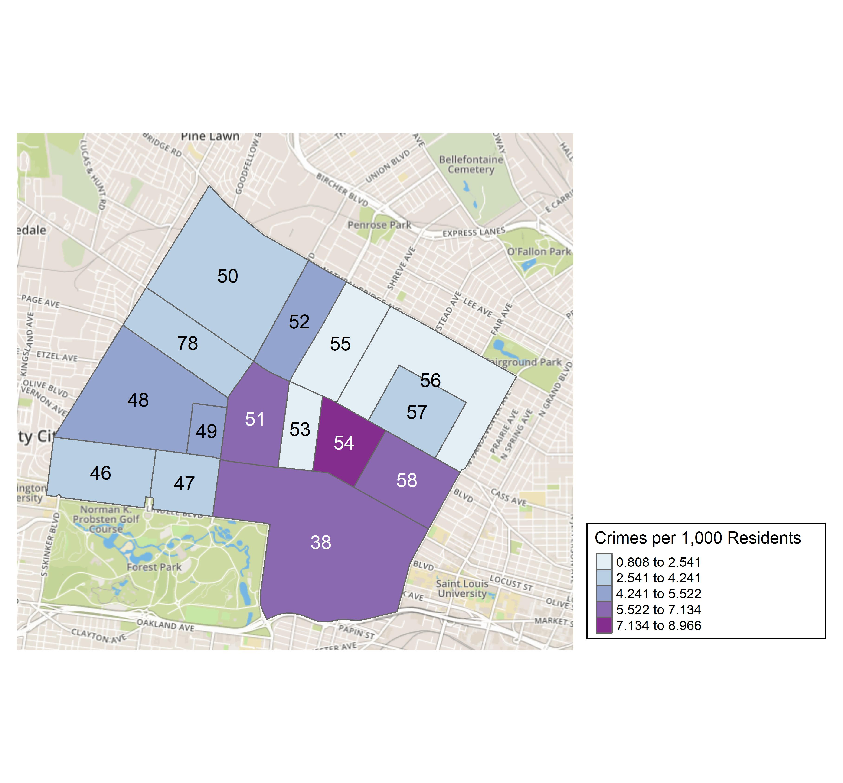
District 5: Crime Rates Map

Slide 19
District 5: Density Map Explanation
There are 15 neighborhoods in District 5.
The minimum number of crimes in one neighborhood was 3 (Fountain Park)
The maximum number of crimes in one neighborhood was 100 (Central West End)
The mean number of crimes in one neighborhood was 19.33
The minimum rate of crimes in one neighborhood was 0.81 (Greater Ville)
The maximum rate of crimes in one neighborhood was 8.97 (Lewis Place)
The mean rate of crimes in one neighborhood was 4.64

Slide 20
Skinker DeBaliviere: Neighborhood Detail
Appendix 1

Slide 21
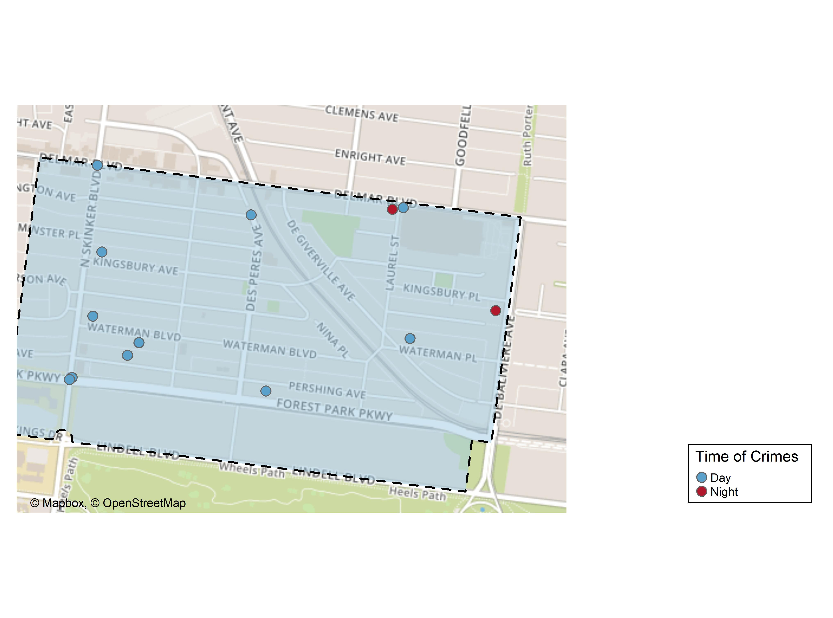
Skinker DeBaliviere: Time of Crimes Map

Slide 22
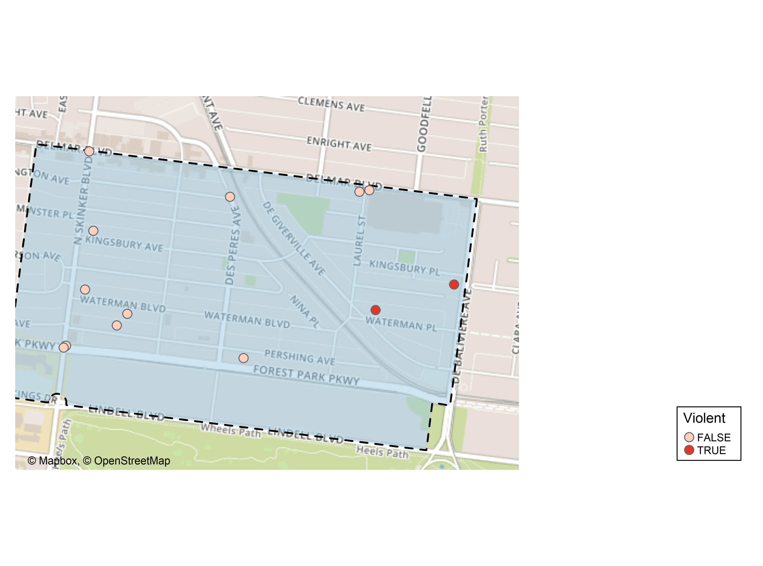
Skinker DeBaliviere: Violent Crime Map

Slide 23
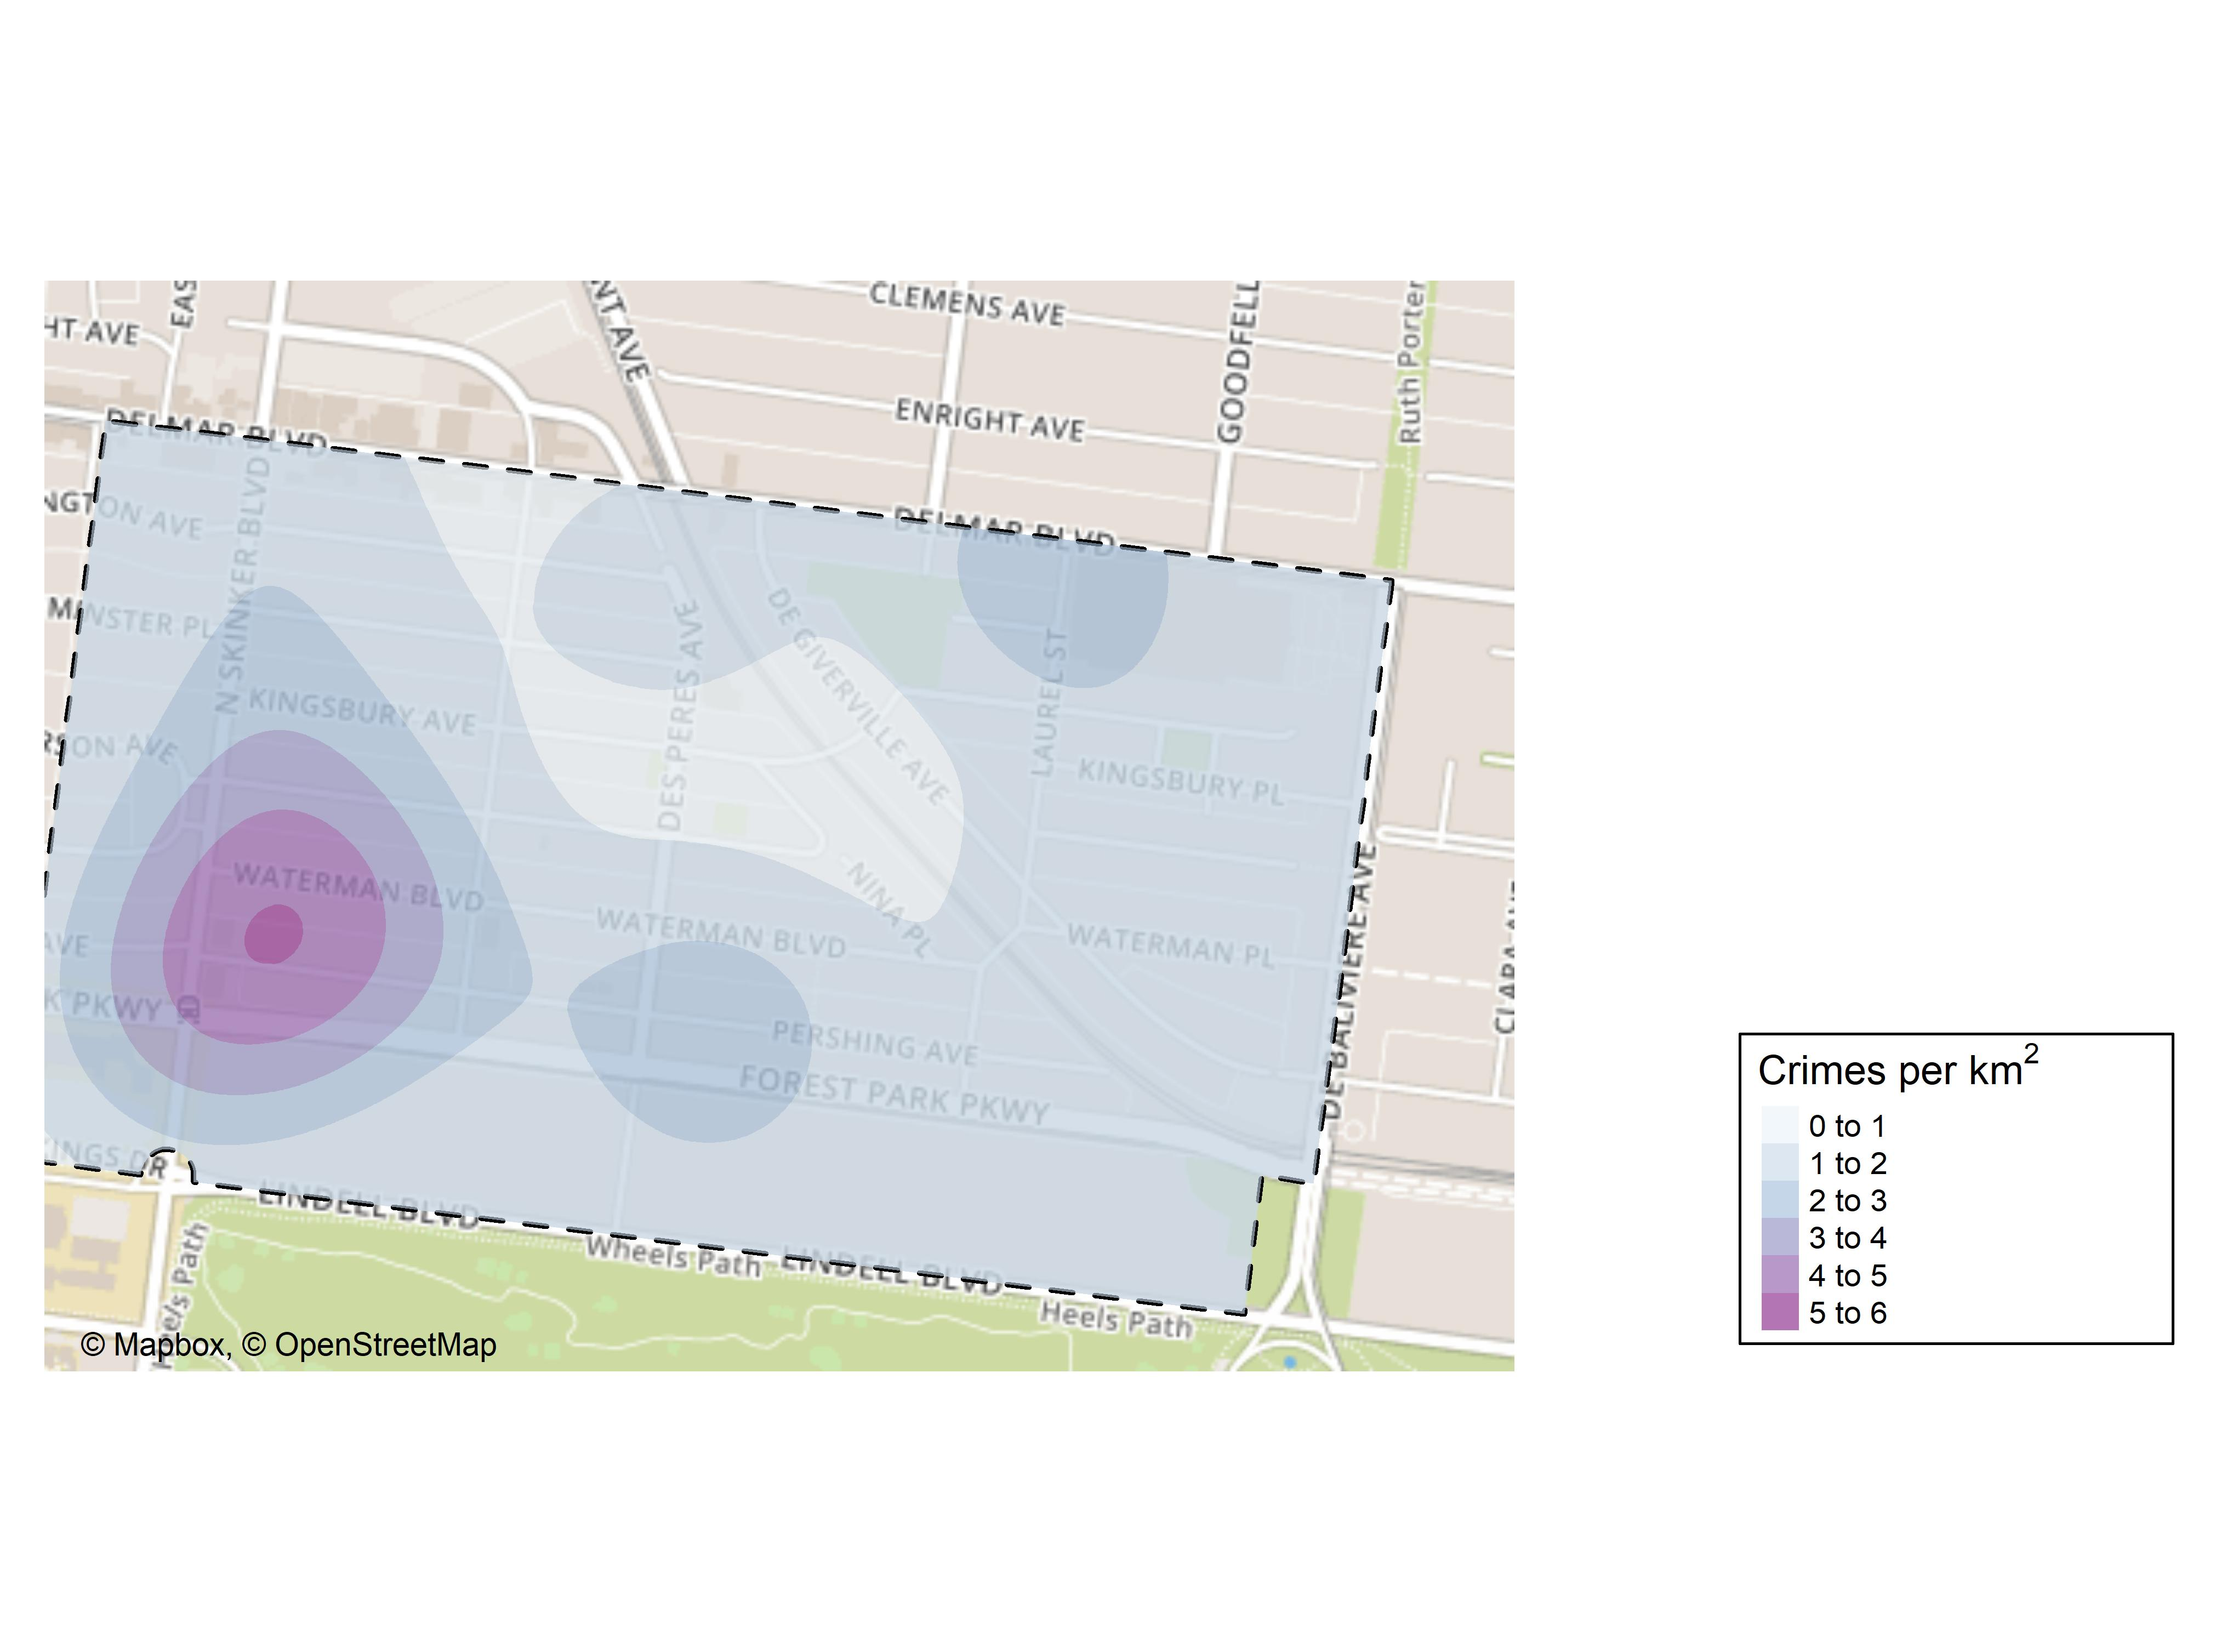
Skinker DeBaliviere: Crime Density Map

Slide 24
Skinker DeBaliviere: Larceny Breakdown
Day of the Week | Number of Crimes
Sun | 3
Mon | 1
Tue | 1
Wed | 2
Thu | 2
Sat | 1
Total | 10
Time of Day | Number of Crimes
Day | 10
Total | 10
Type of Larceny | Number of Crimes
All Other | 4
From Building | 3
From Motor Vehicle | 1
Motor Vehicle Parts | 1
Purse Snatching | 1
Total | 10
Monetary | Number of Crimes
$500 - $24,999 | 4
Under $500 | 5
 | 1
Total | 10

Slide 25
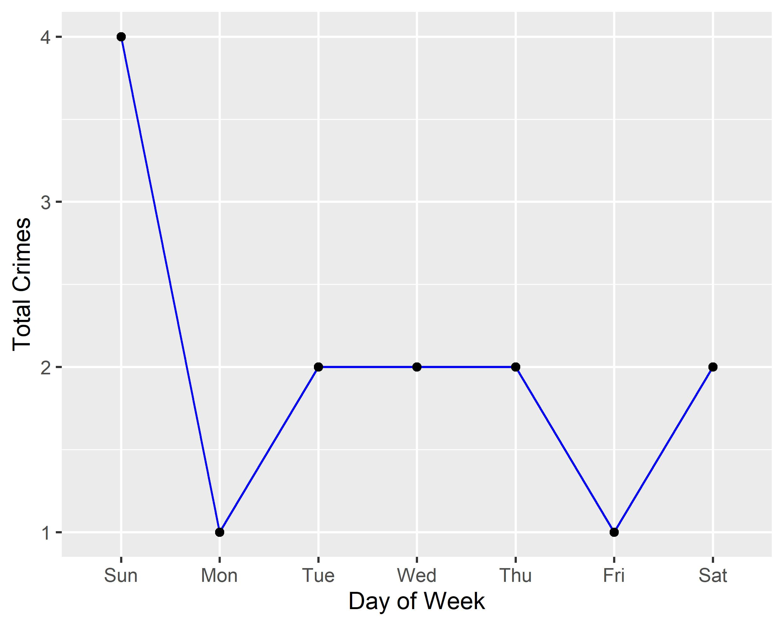
Skinker DeBaliviere: Total Crimes by Days of the Week

Slide 26
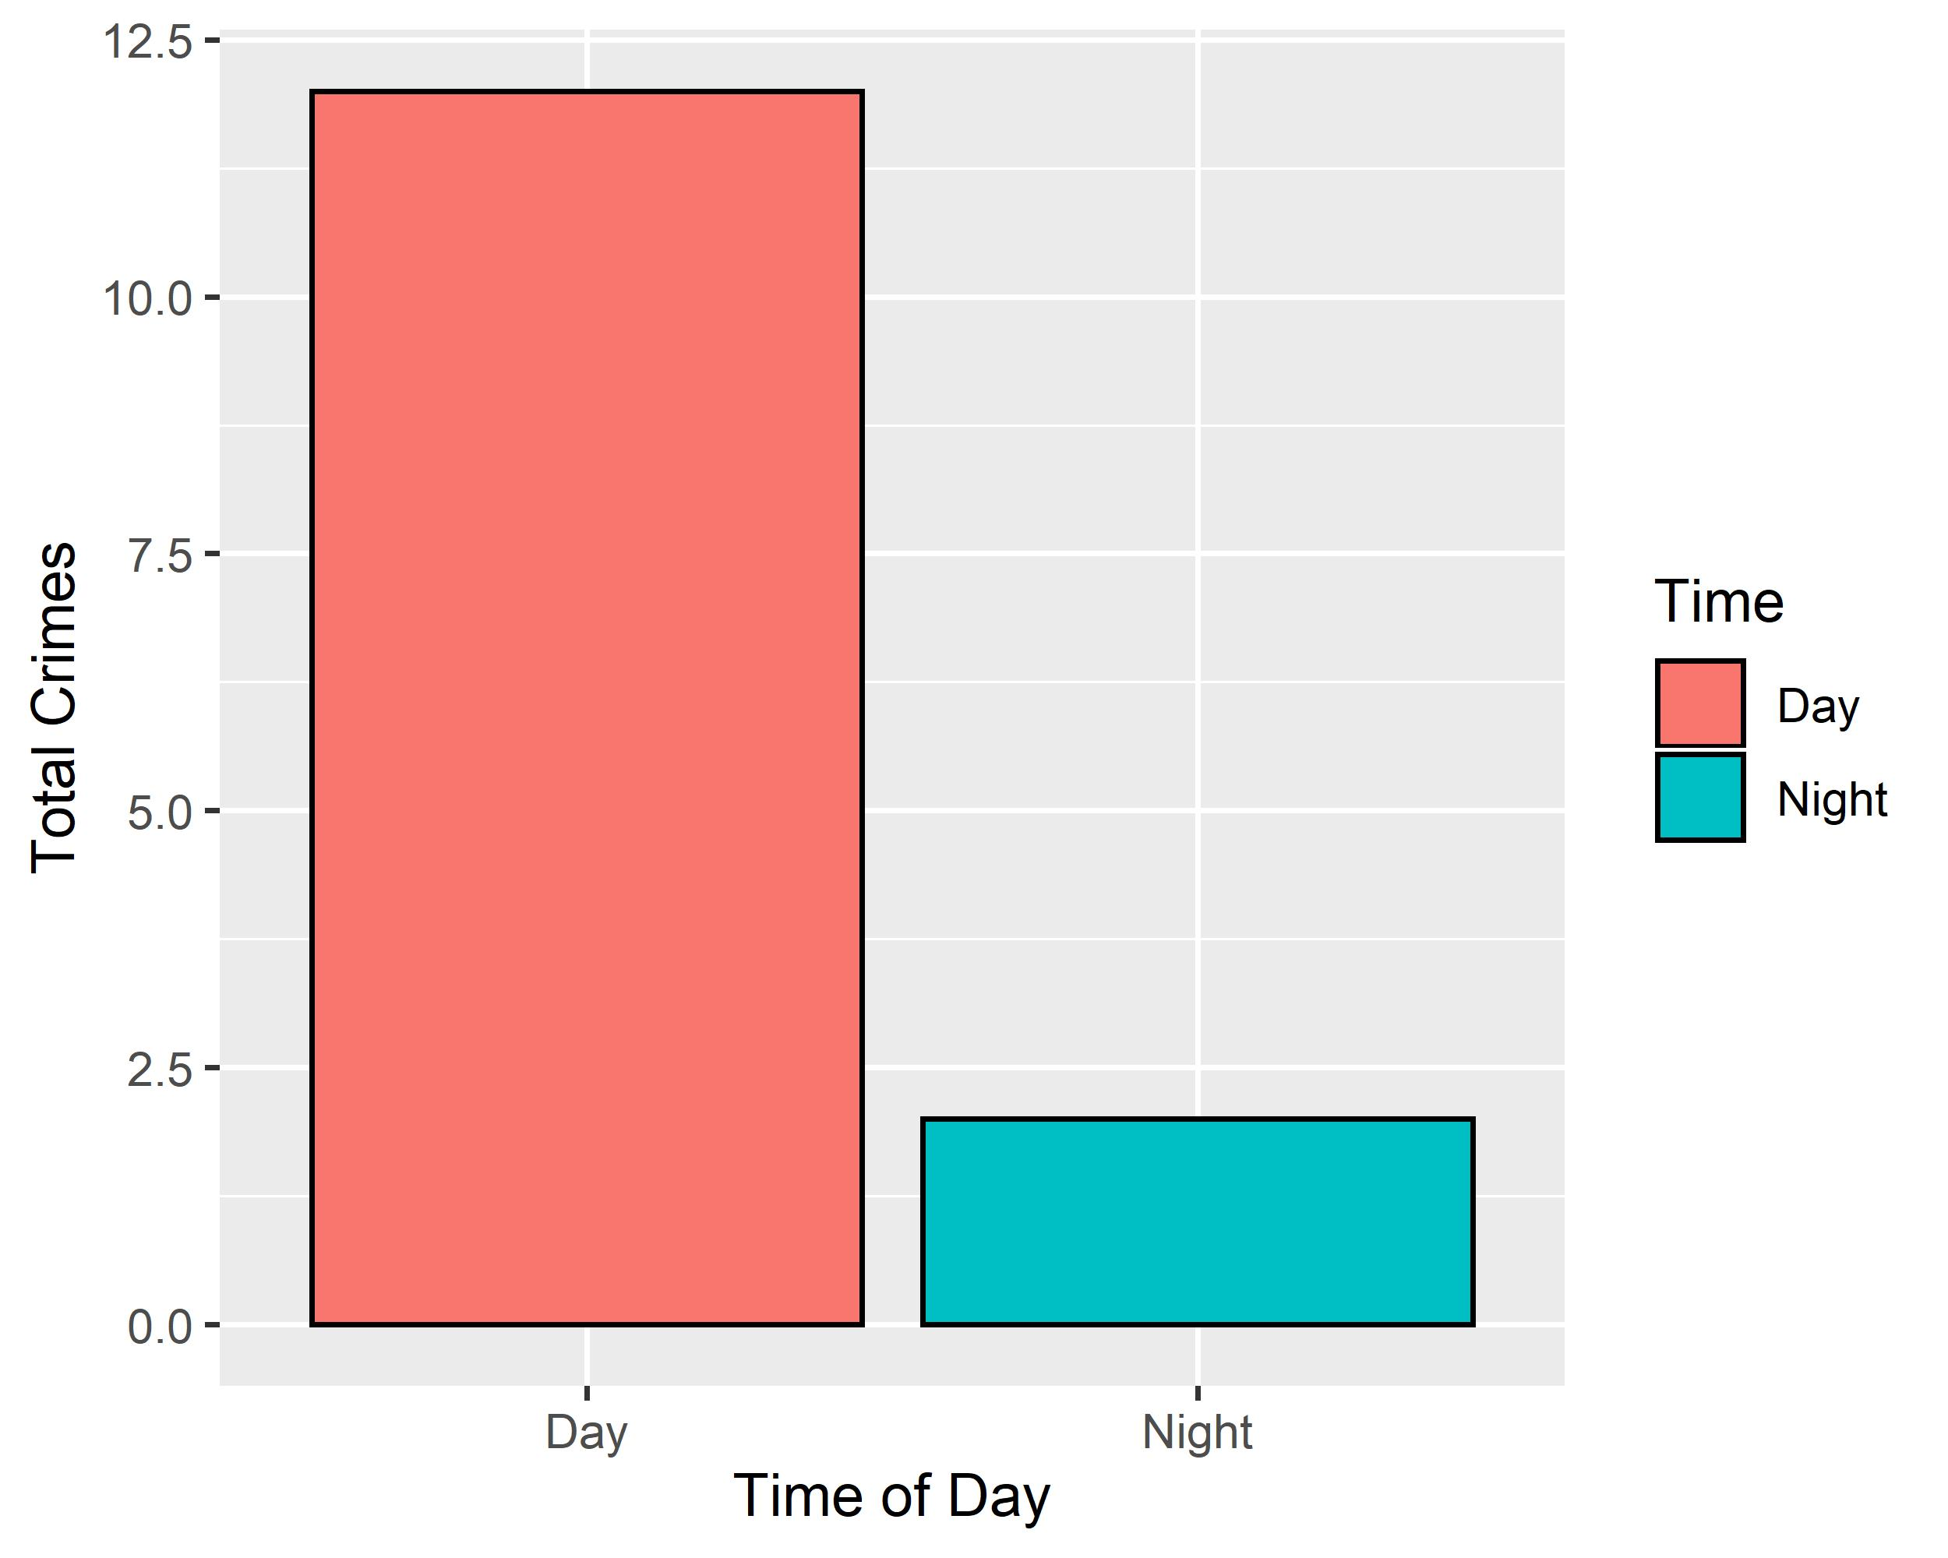
Skinker DeBaliviere: Crimes by Time of Day

Slide 27
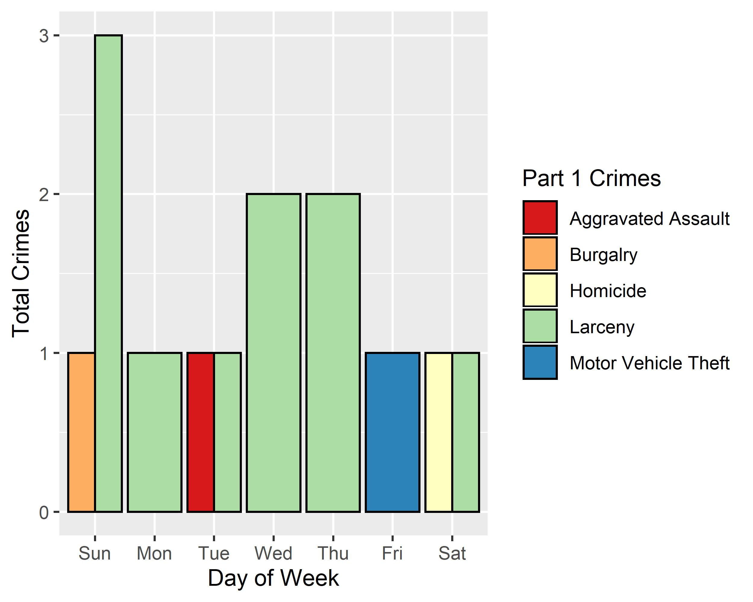
Skinker DeBaliviere: Crimes by Day & Category

Slide 28
DeBaliviere Place: Neighborhood Detail
Appendix 2

Slide 29
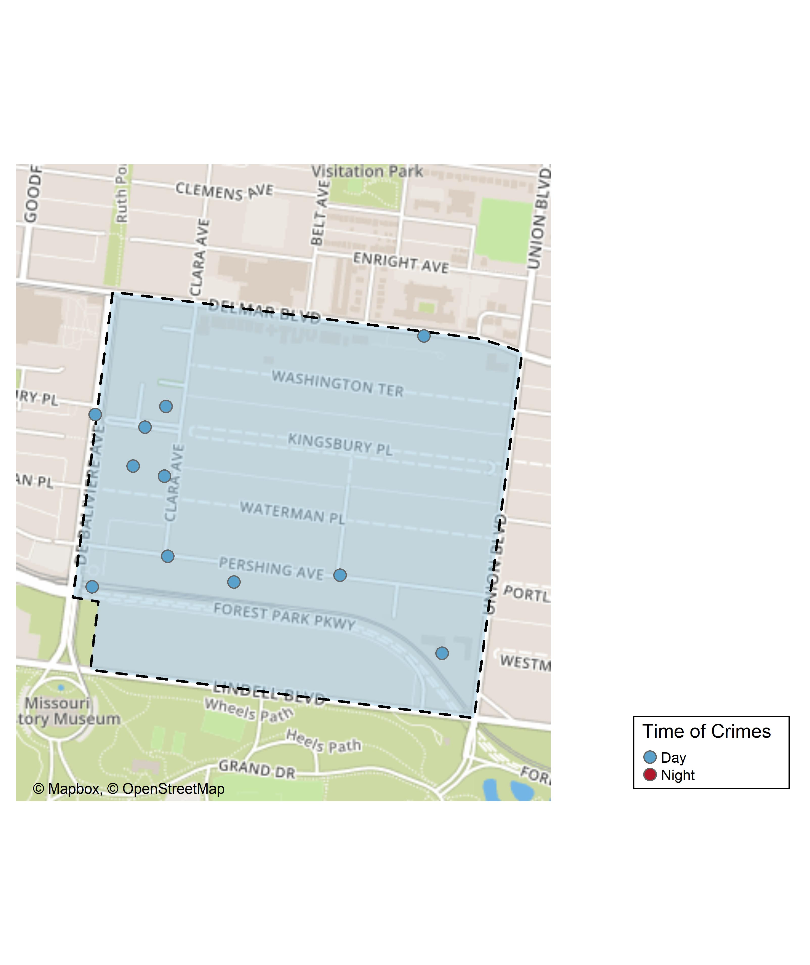
DeBaliviere Place: Time of Crimes Map

Slide 30
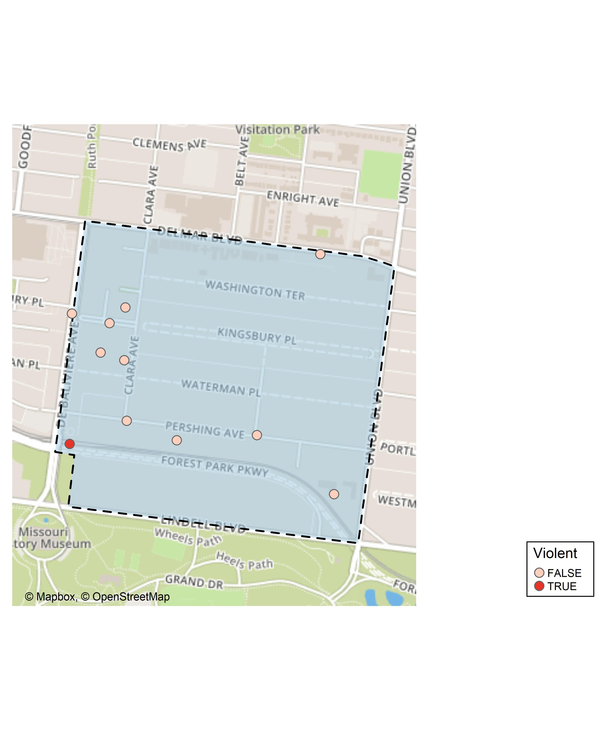
DeBaliviere Place: Violent Crime Map

Slide 31
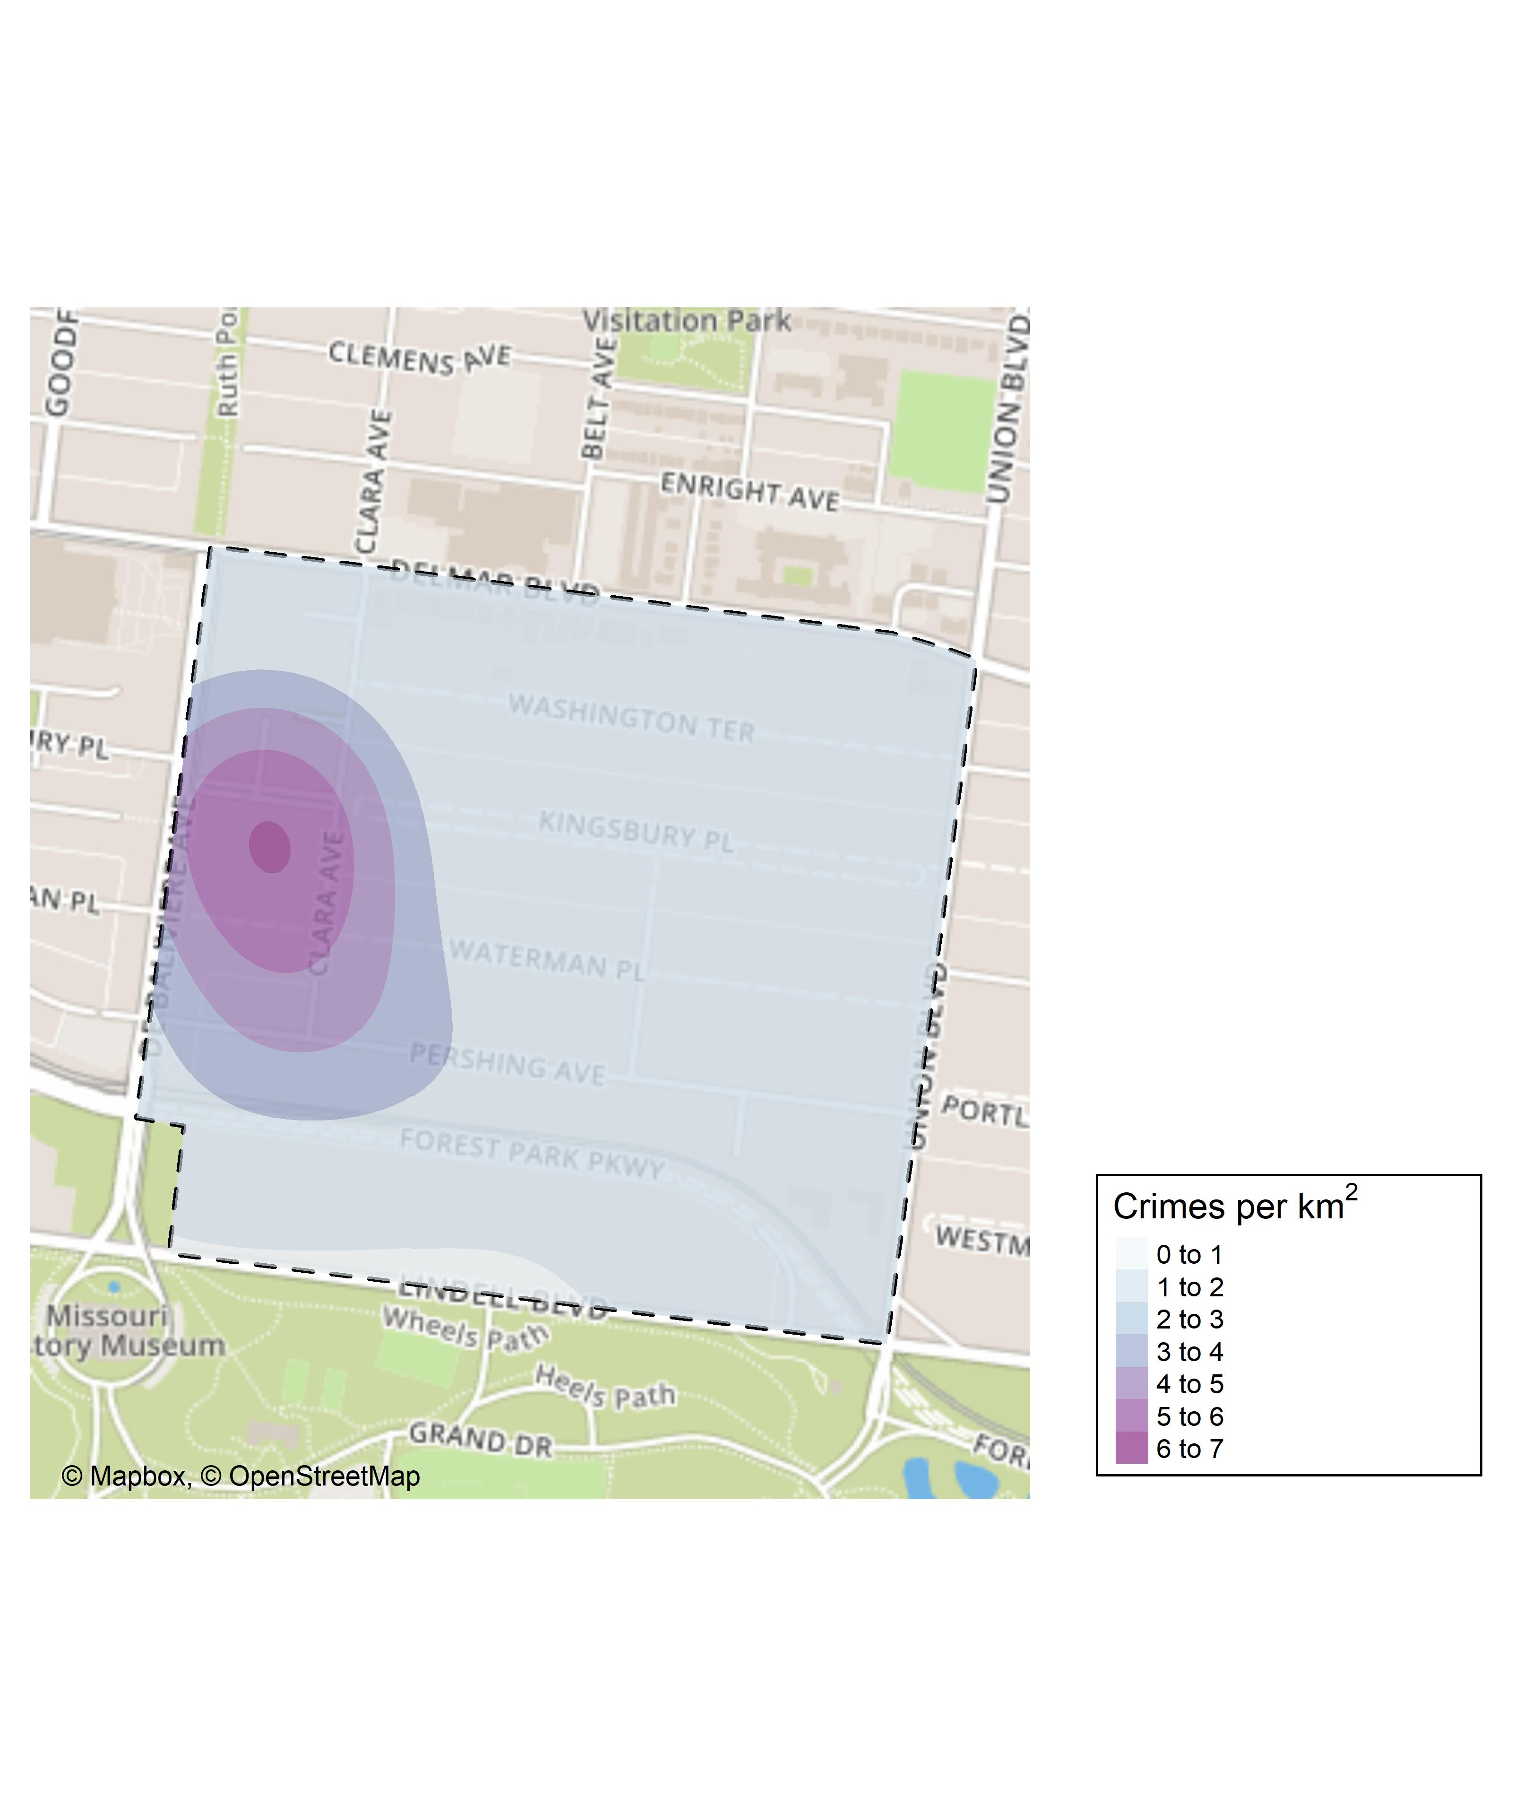
DeBaliviere Place: Crime Density Map

Slide 32
DeBaliviere Place: Larceny Breakdown
Day of the Week | Number of Crimes
Sun | 2
Mon | 5
Tue | 1
Wed | 2
Thu | 2
Fri | 1
Total | 13
Time of Day | Number of Crimes
Day | 12
Night | 1
Total | 13
Type of Larceny | Number of Crimes
From Building | 2
From Motor Vehicle | 9
Motor Vehicle Parts | 2
Total | 13
Monetary | Number of Crimes
$500 - $24,999 | 3
Under $500 | 10
Total | 13

Slide 33
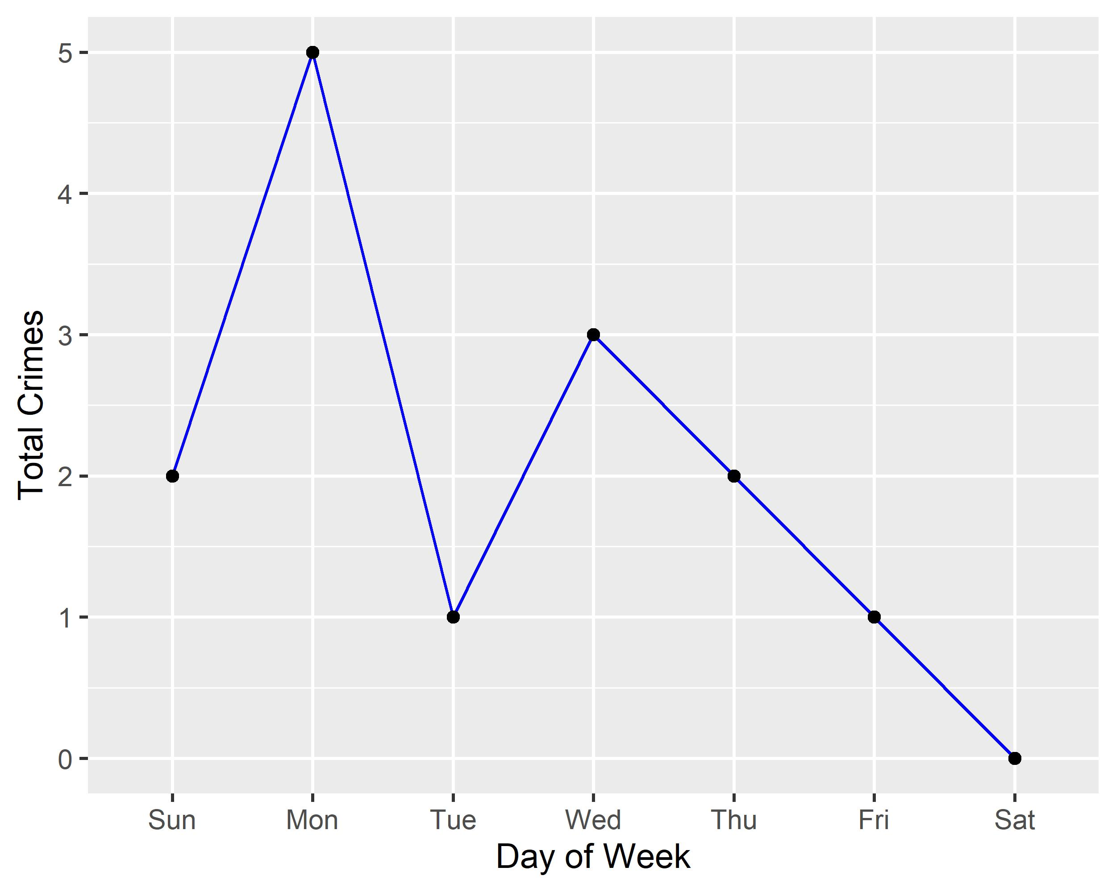
DeBaliviere Place: Total Crimes by Days of the Week

Slide 34
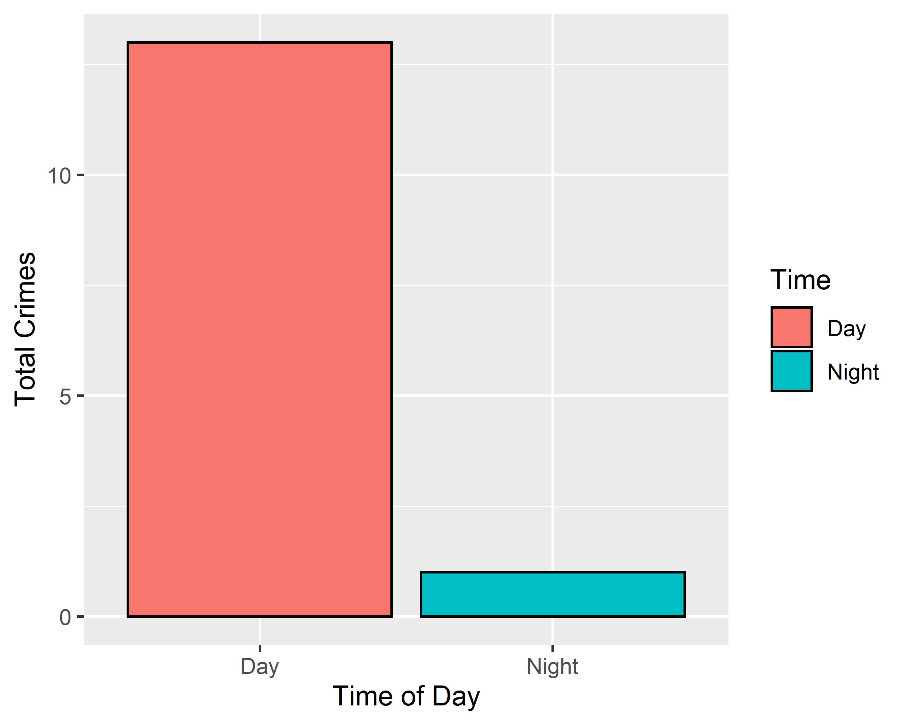
DeBaliviere Place: Crimes by Time of Day

Slide 35
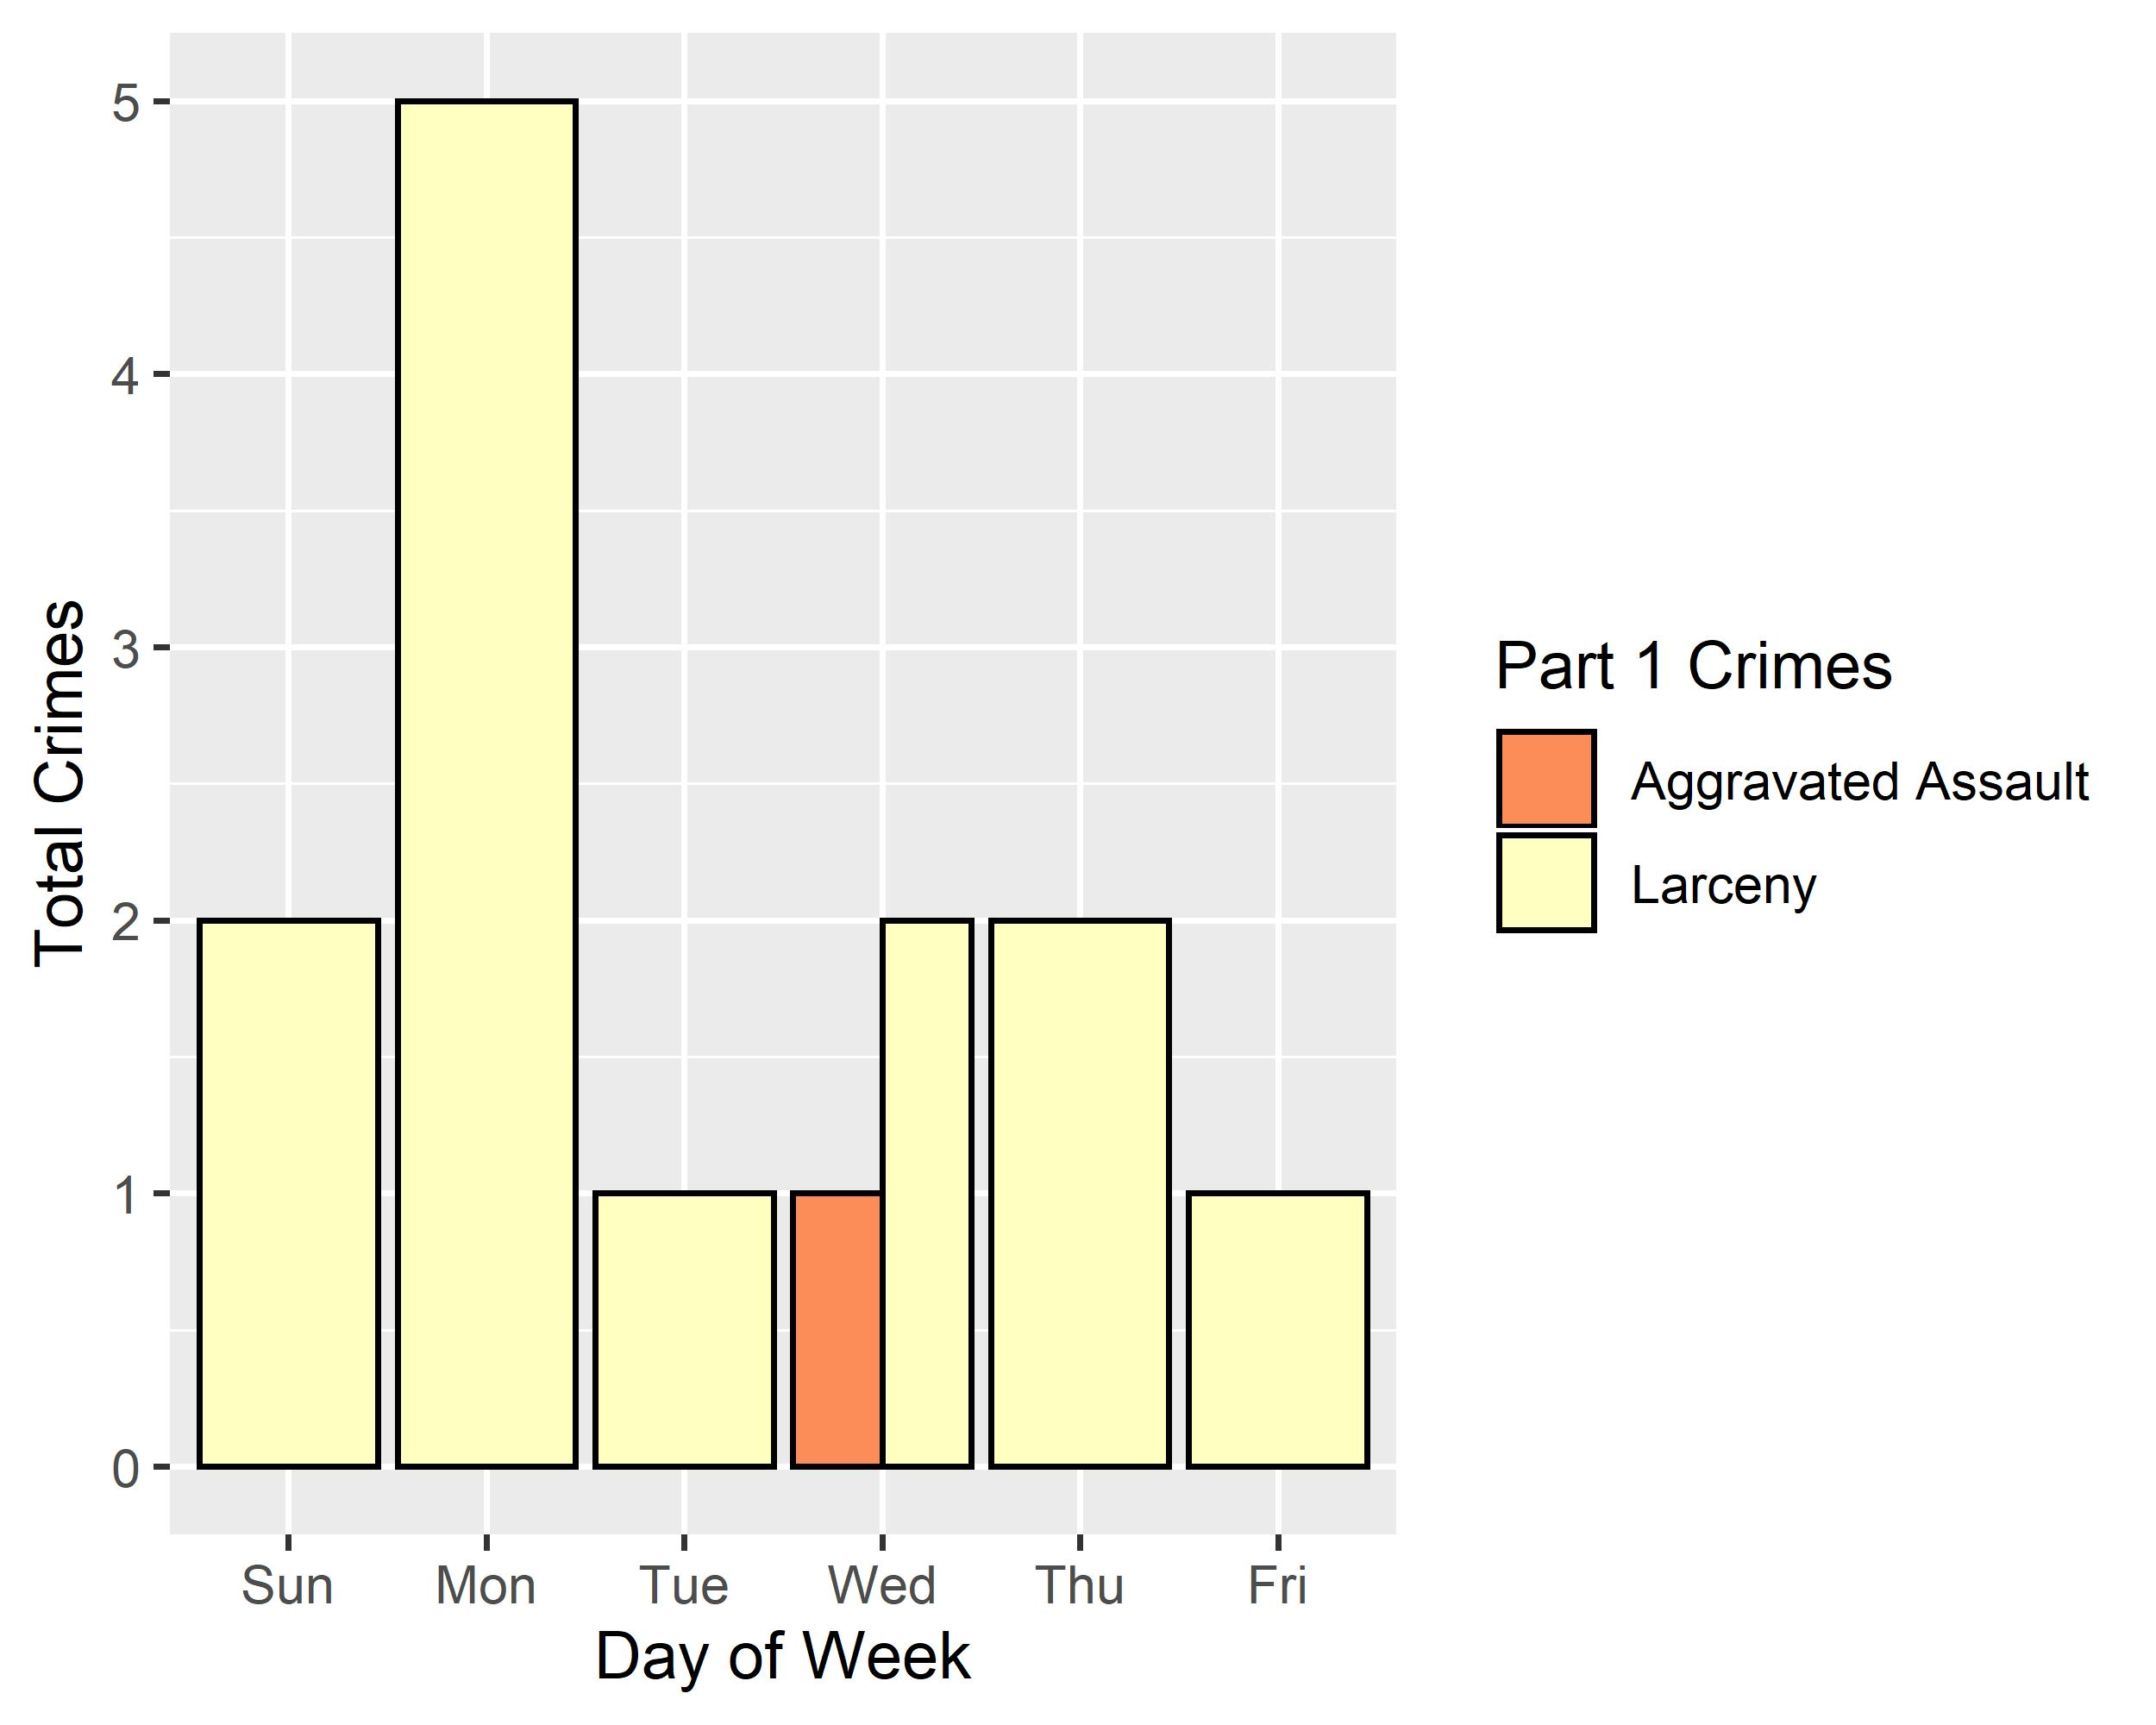
DeBaliviere Place: Crimes by Day & Category

Slide 36
West End: Neighborhood Detail
Appendix 3

Slide 37
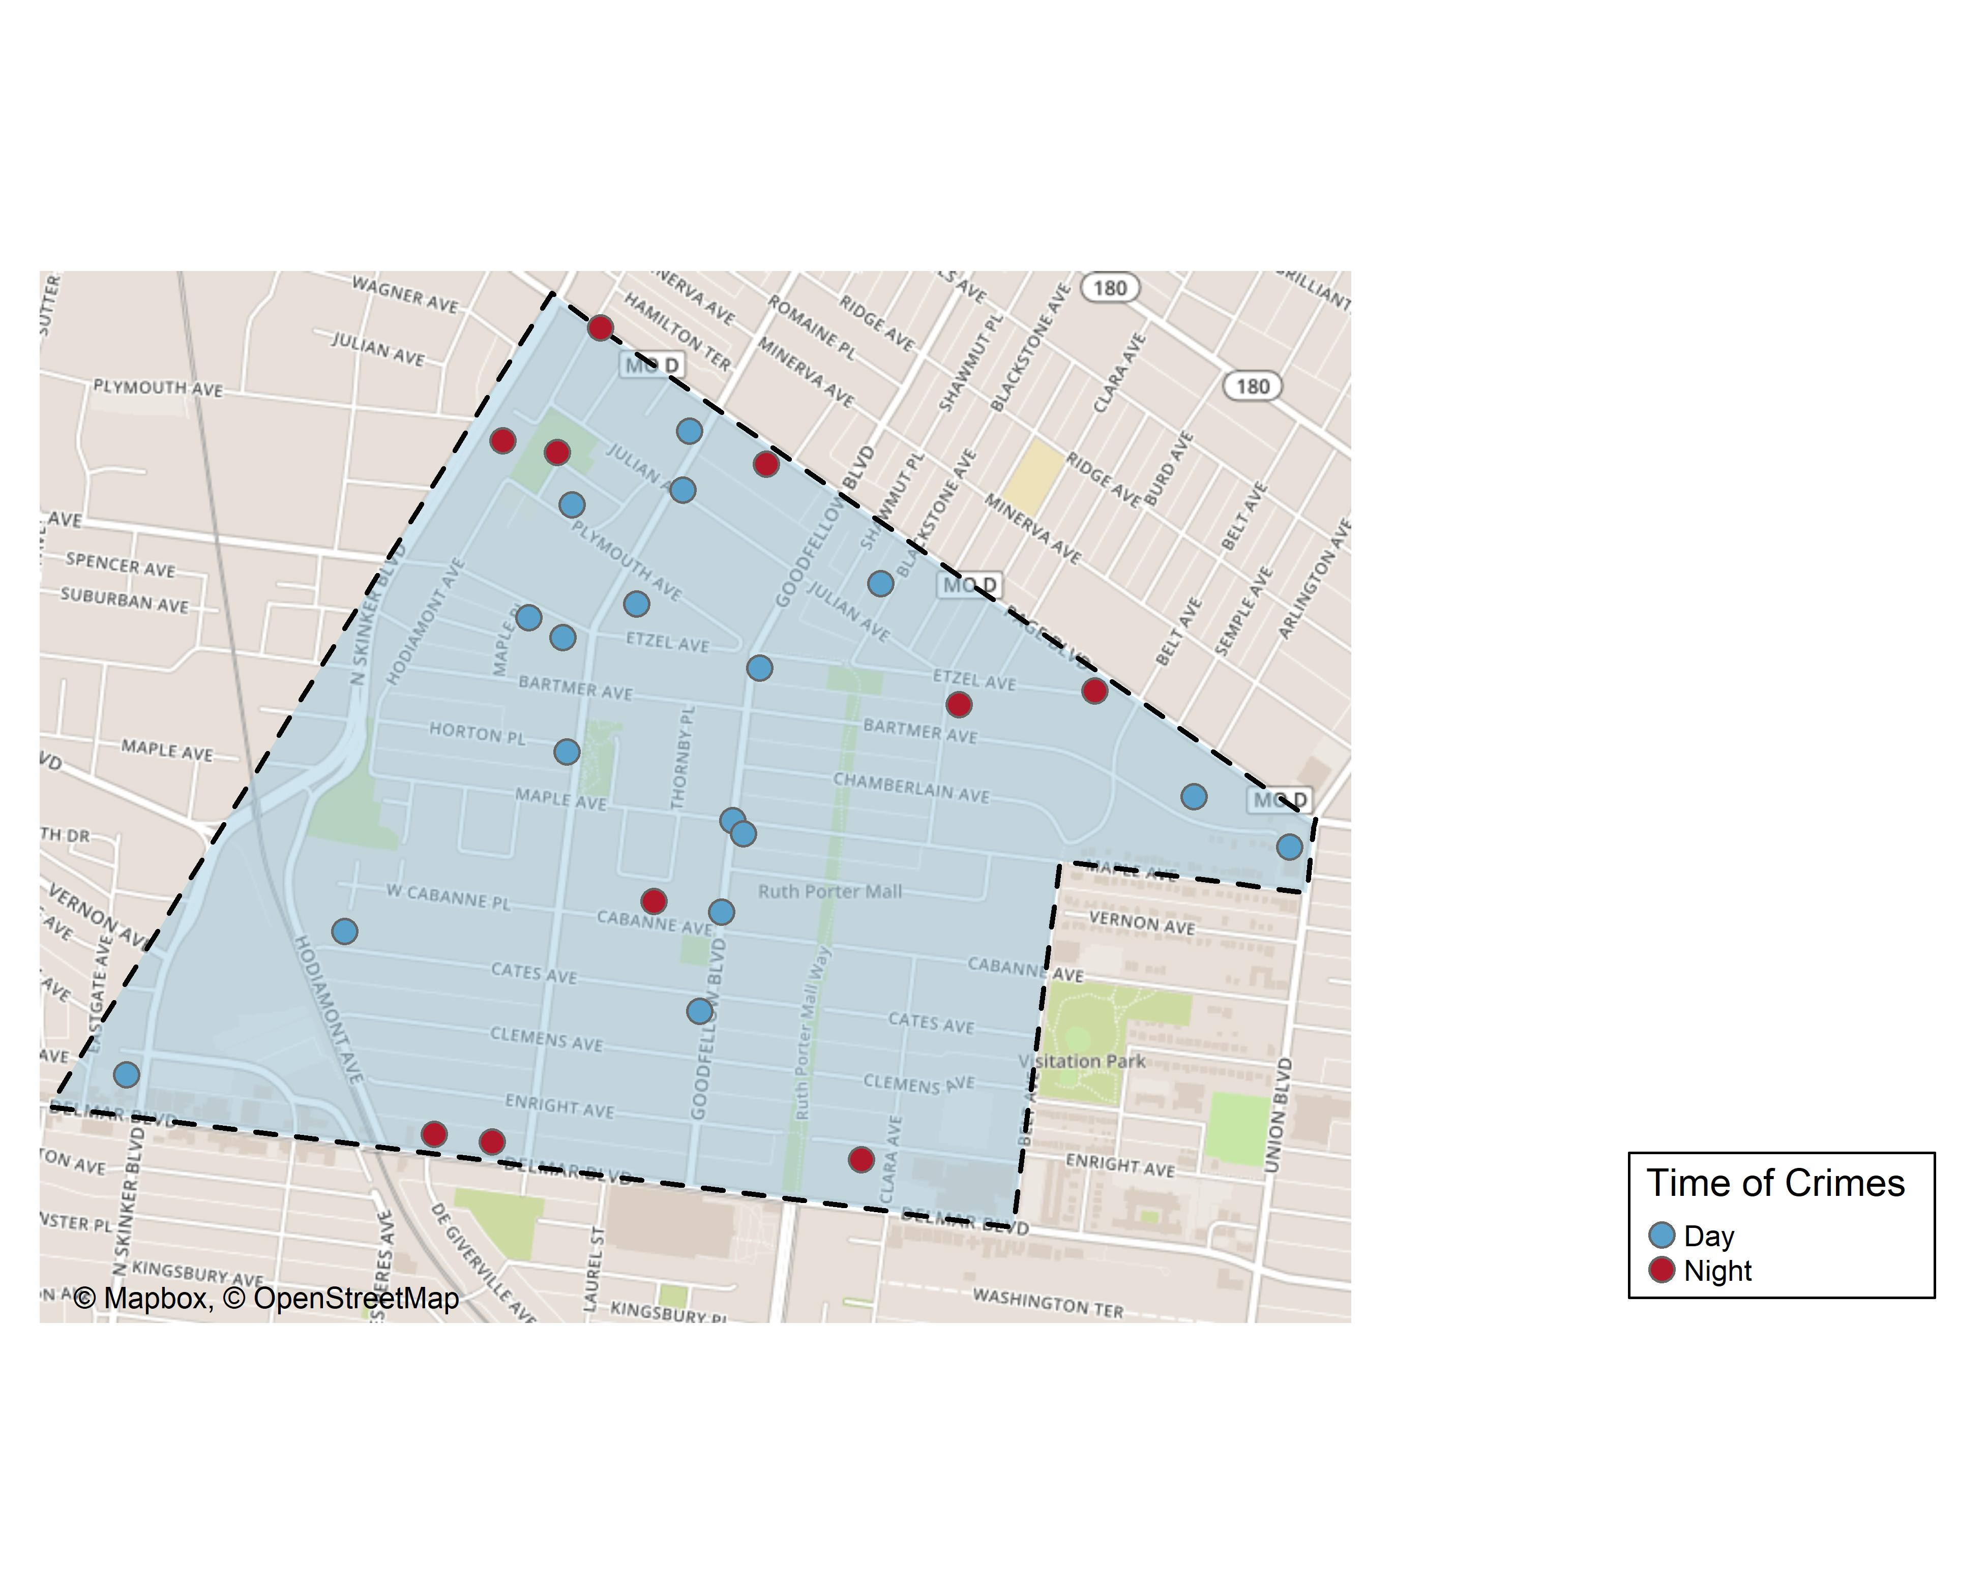
West End: Time of Crimes Map

Slide 38
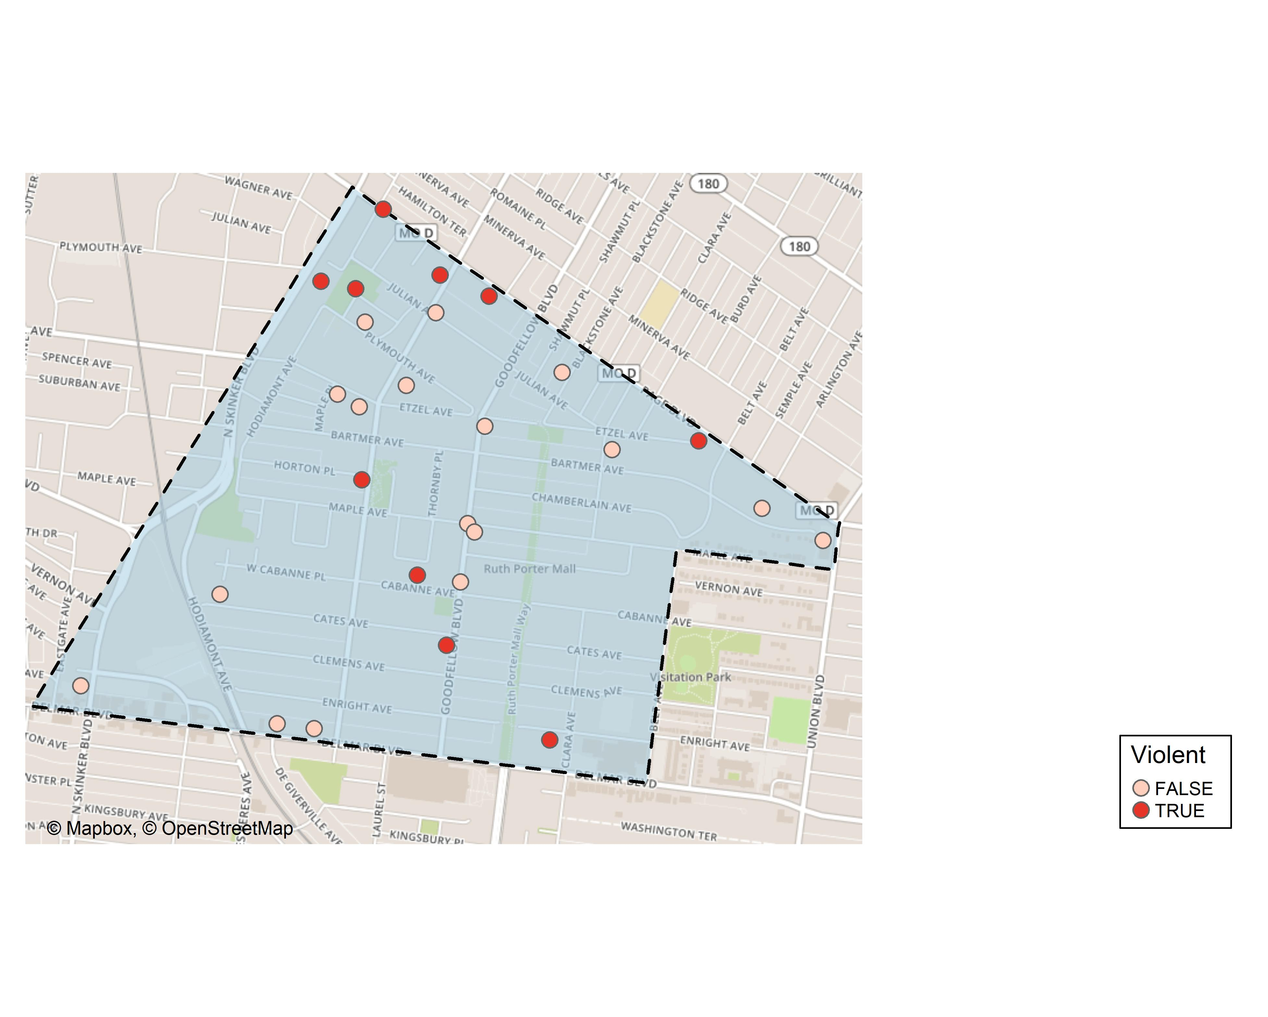
West End: Violent Crime Map

Slide 39
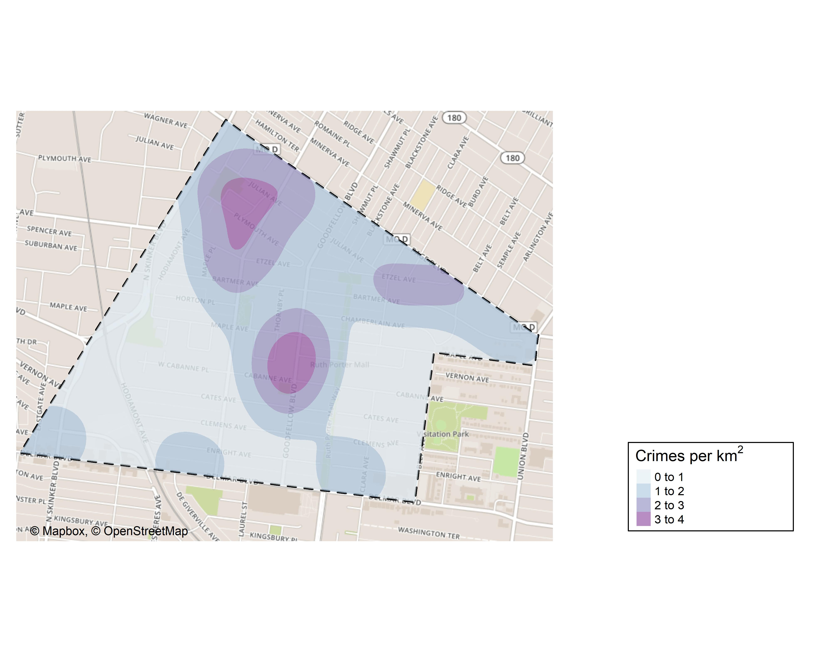
West End: Crime Density Map

Slide 40
West End: Larceny Breakdown
Day of the Week | Number of Crimes
Sun | 1
Mon | 1
Tue | 2
Thu | 1
Fri | 1
Sat | 1
Total | 7
Time of Day | Number of Crimes
Day | 6
Night | 1
Total | 7
Type of Larceny | Number of Crimes
All Other | 5
From Motor Vehicle | 2
Total | 7
Monetary | Number of Crimes
$500 - $24,999 | 3
Under $500 | 4
Total | 7

Slide 41
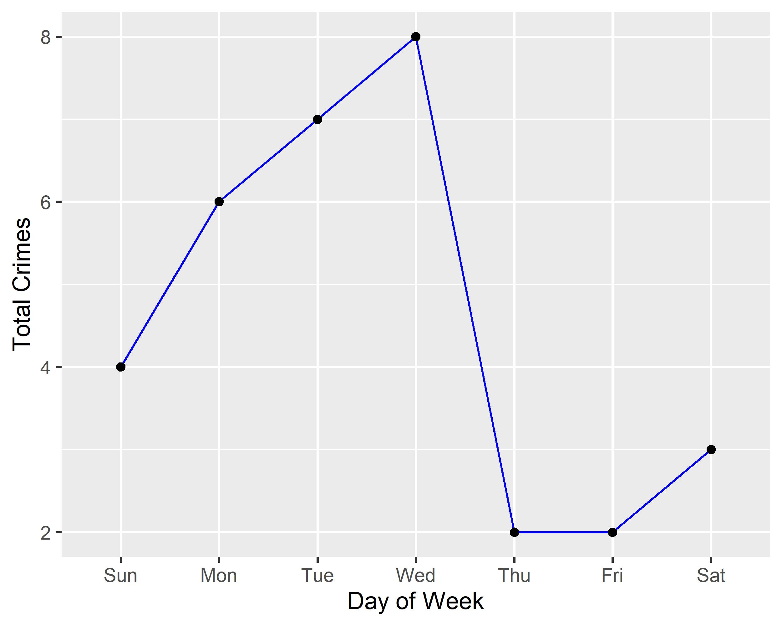
West End: Total Crimes by Days of the Week

Slide 42
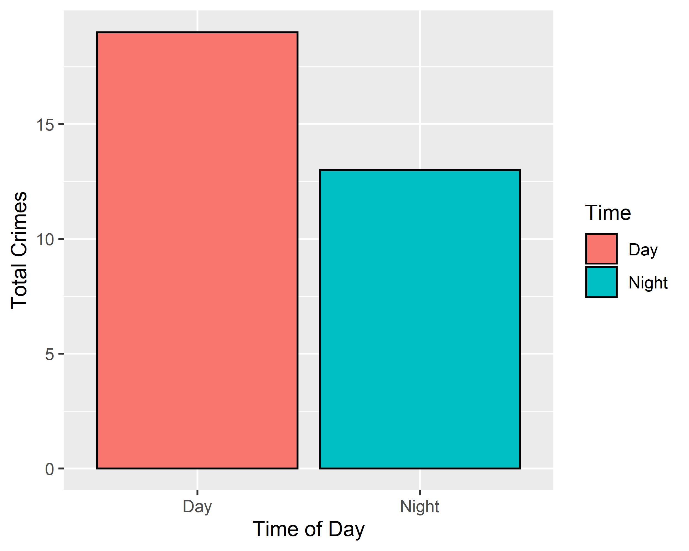
West End: Crimes by Time of Day

Slide 43
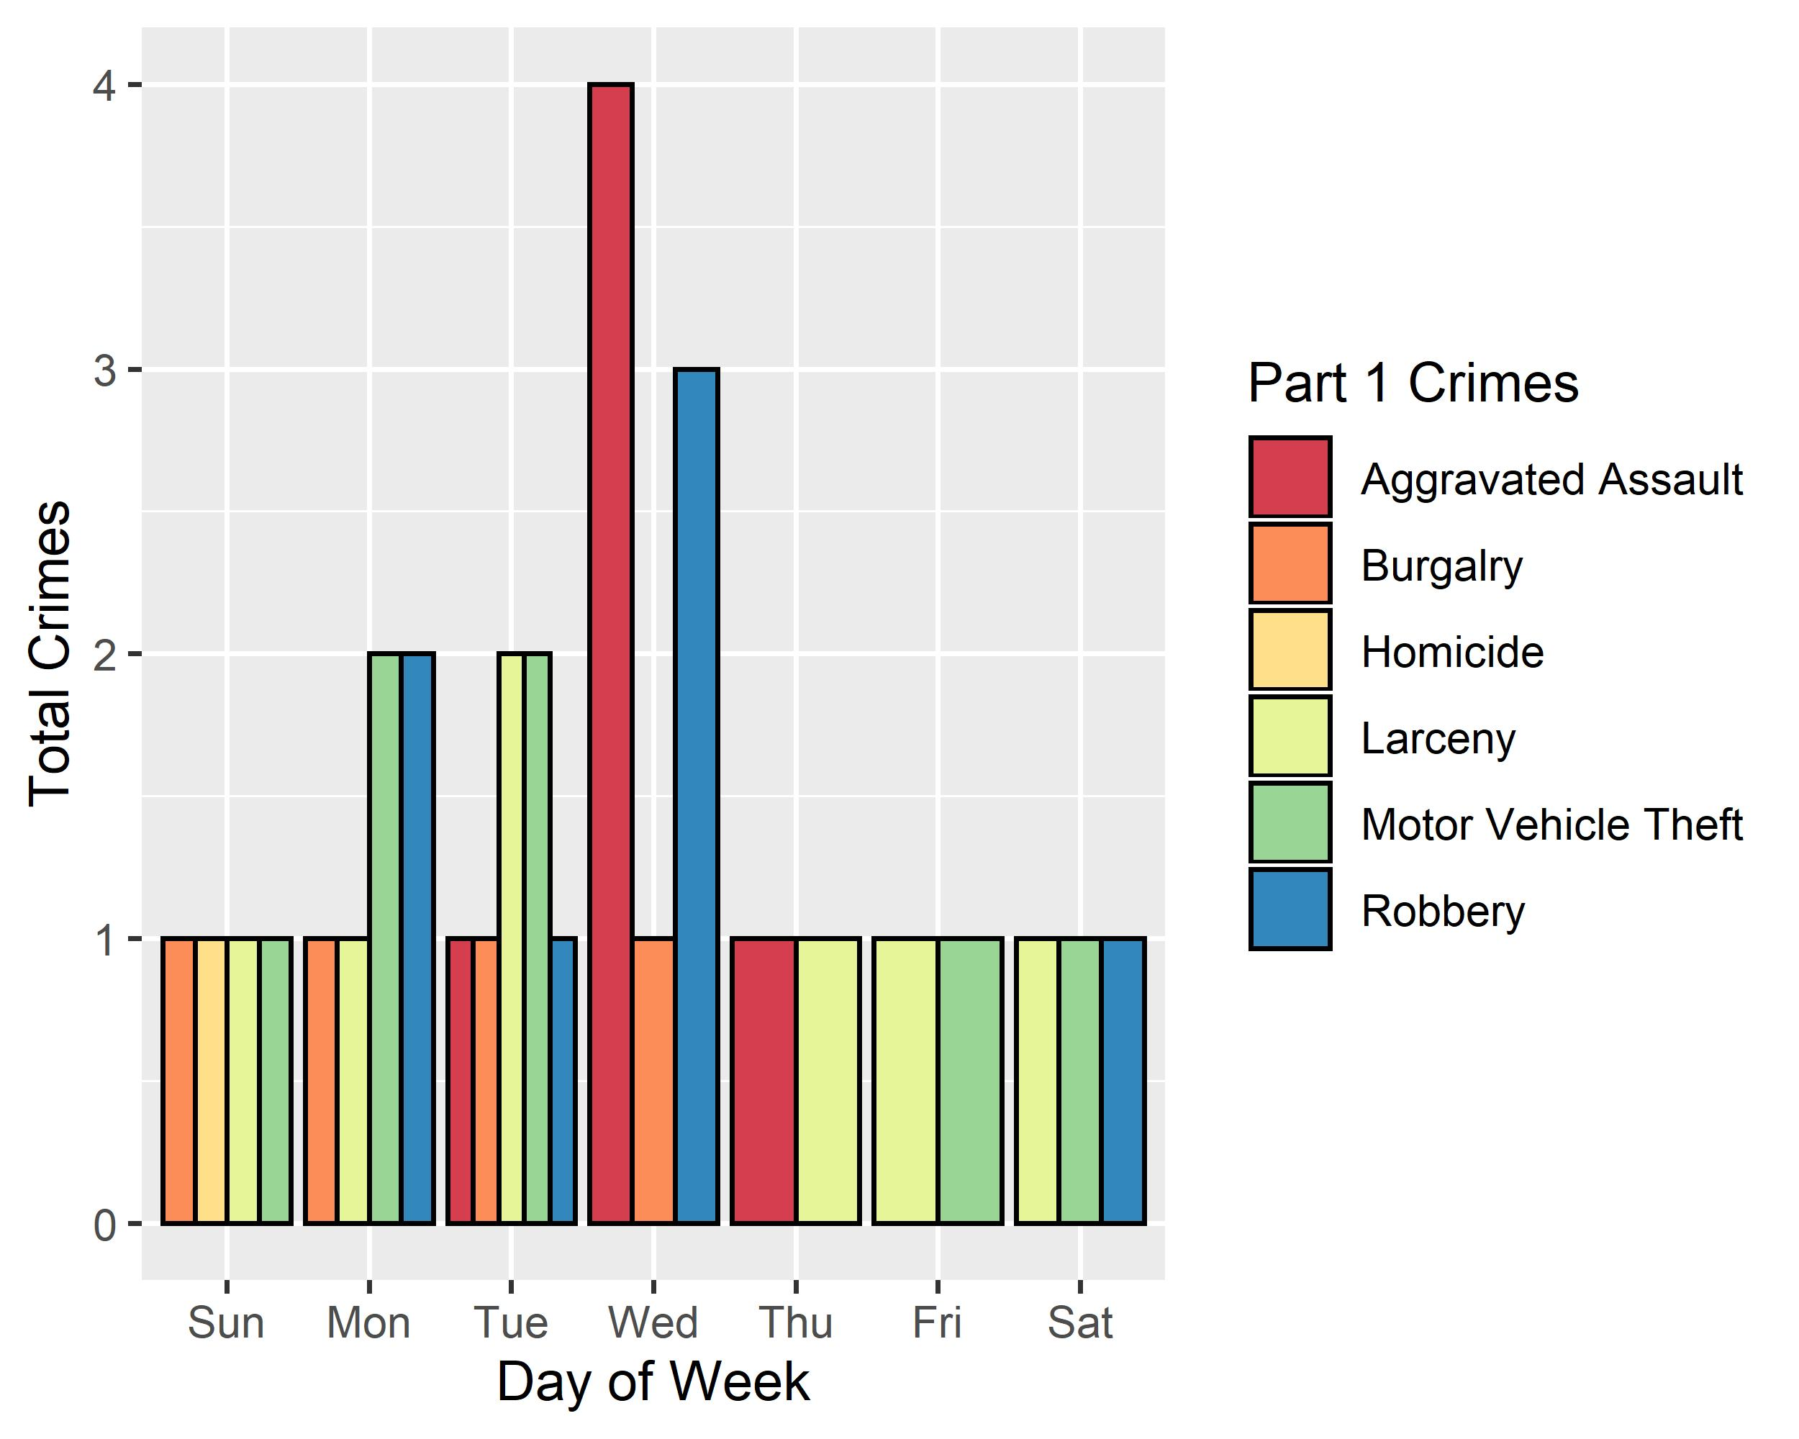
West End: Crimes by Day & Category

Slide 44
Visitation Park: Neighborhood Detail
Appendix 4

Slide 45
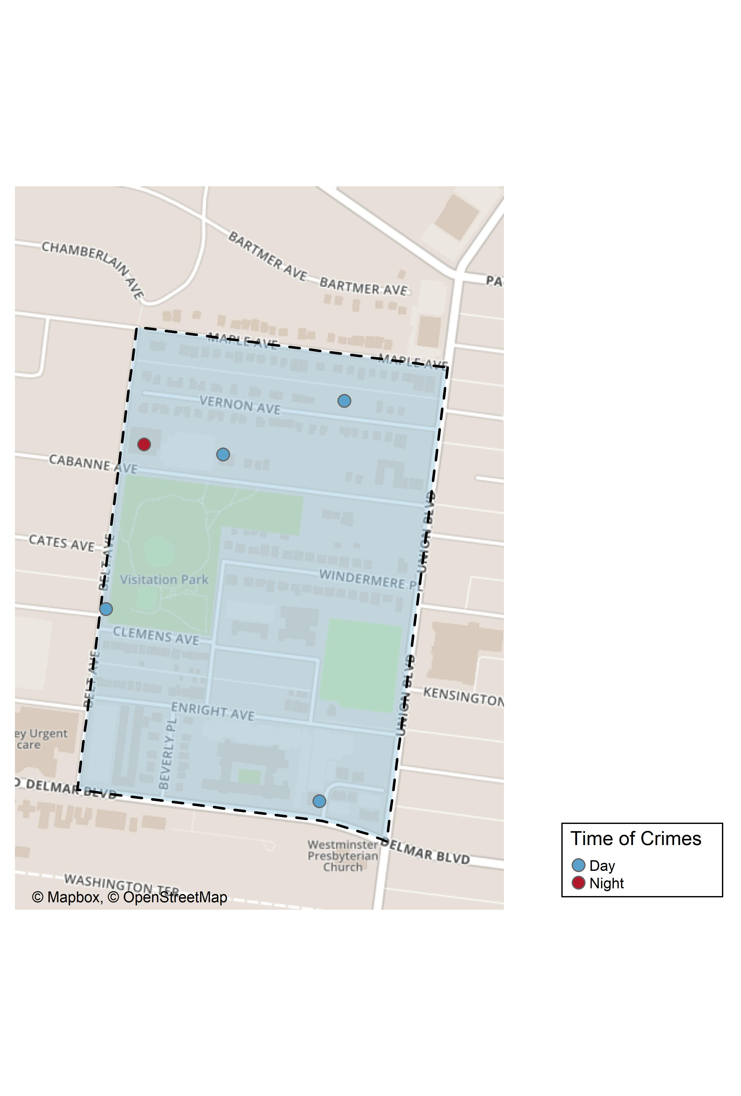
Visitation Park: Time of Crimes Map

Slide 46
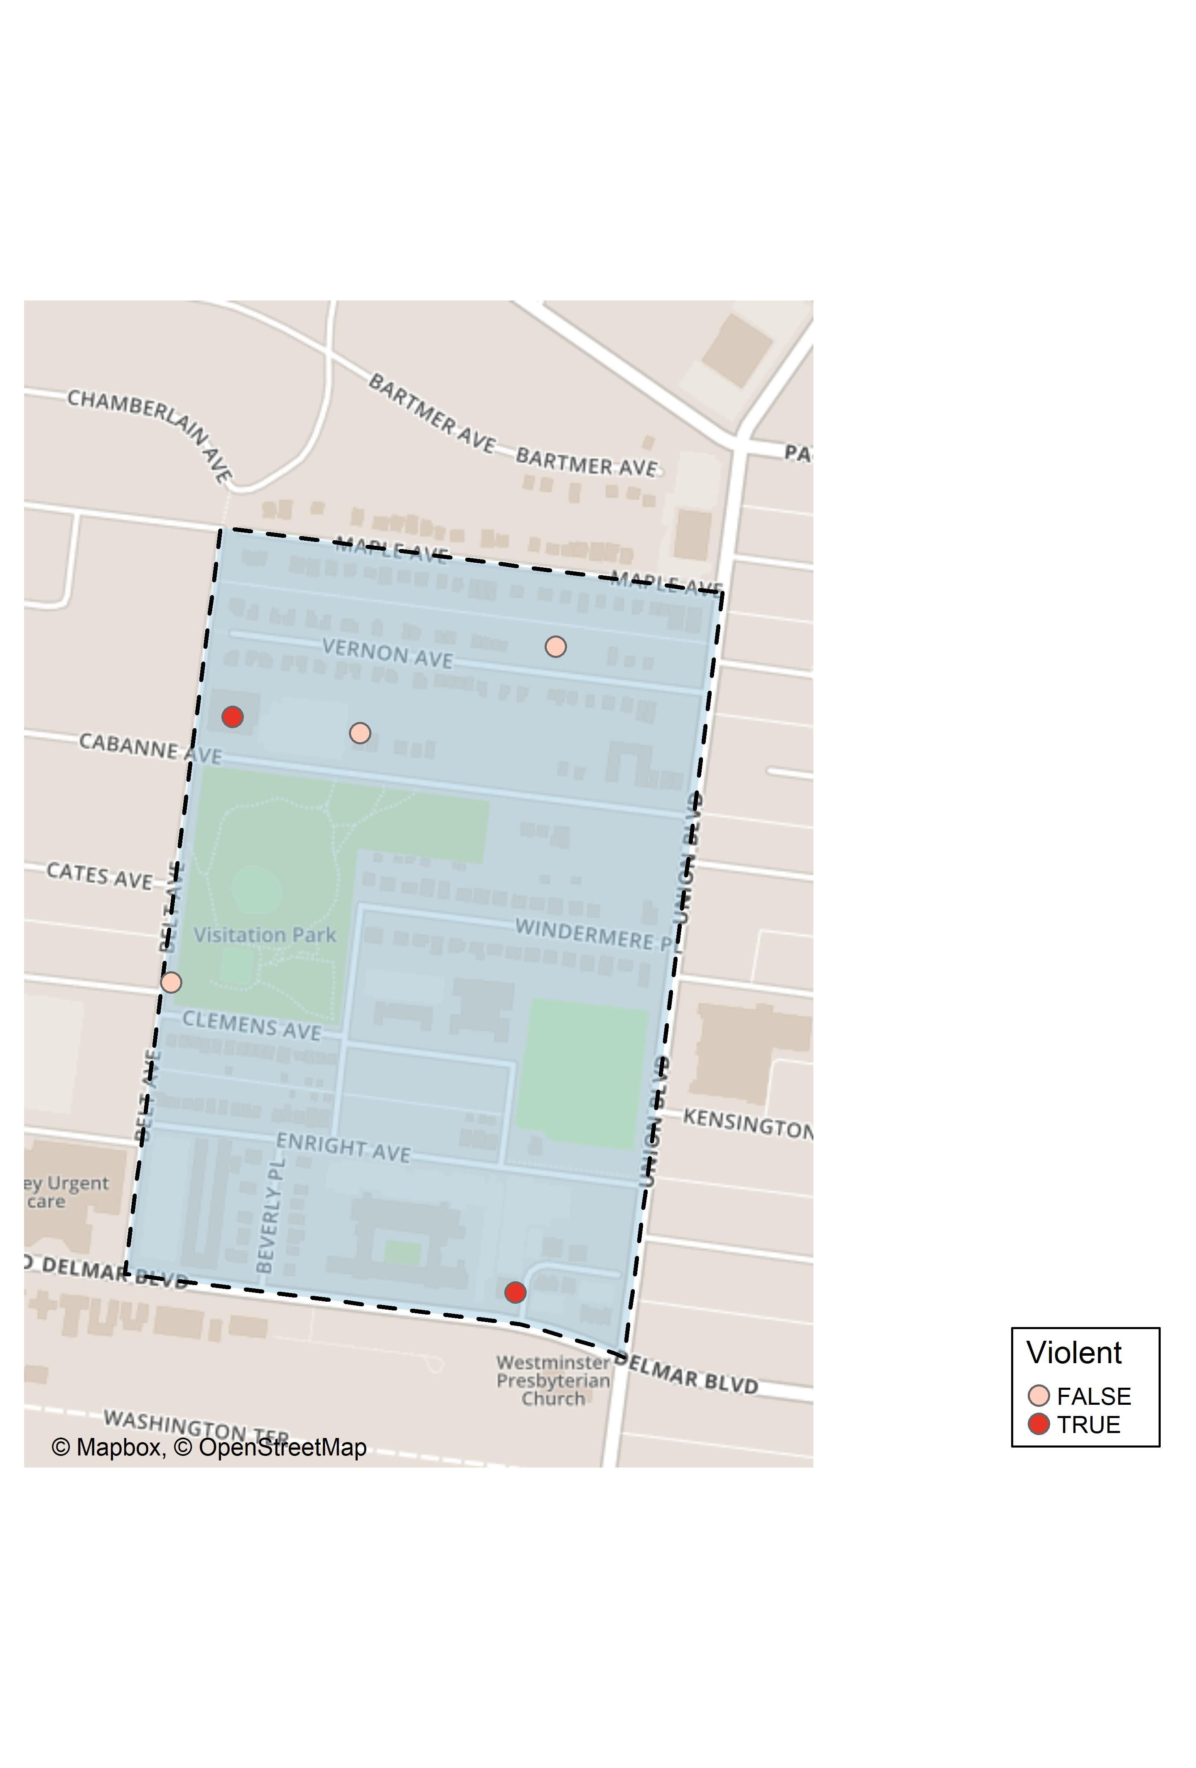
Visitation Park: Violent Crime Map

Slide 47
Visitation Park: Larceny Breakdown
Day of the Week | Number of Crimes
Thu | 1
Fri | 1
Sat | 1
Total | 3
Time of Day | Number of Crimes
Day | 3
Total | 3
Type of Larceny | Number of Crimes
All Other | 1
Motor Vehicle Parts | 2
Total | 3
Monetary | Number of Crimes
$500 - $24,999 | 1
Under $500 | 2
Total | 3

Slide 48
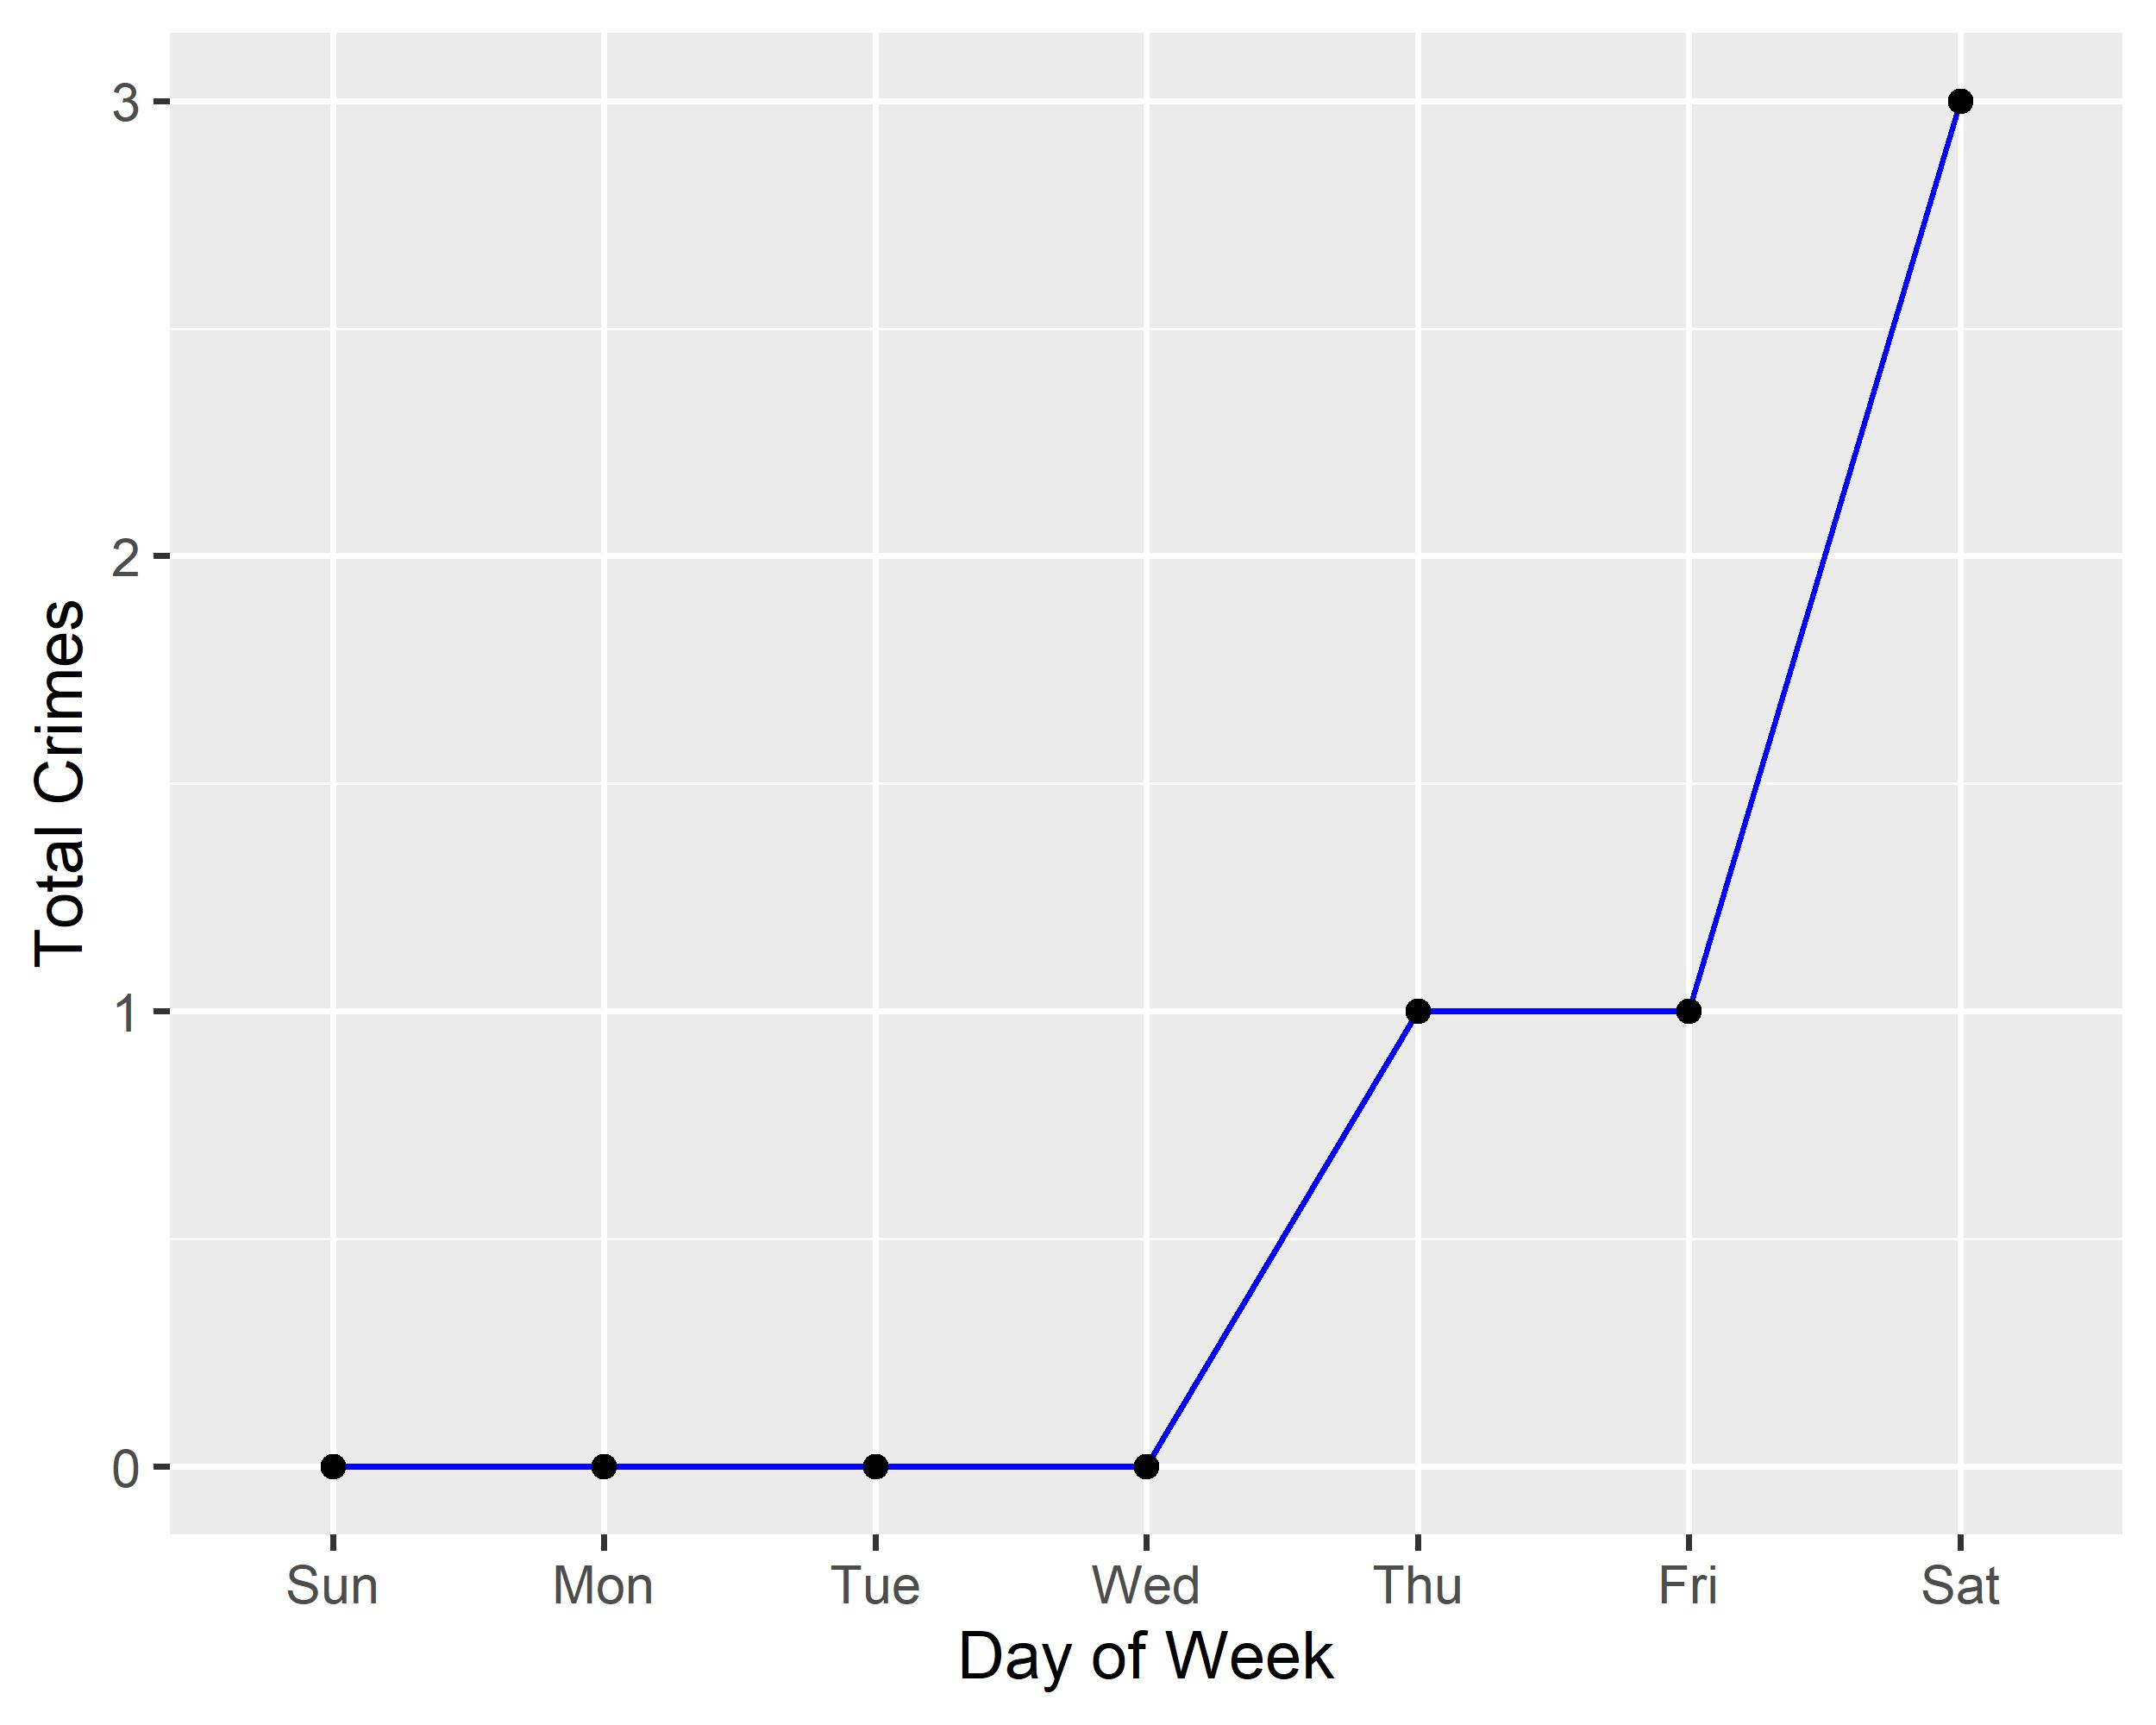
Visitation Park: Total Crimes by Days of the Week

Slide 49
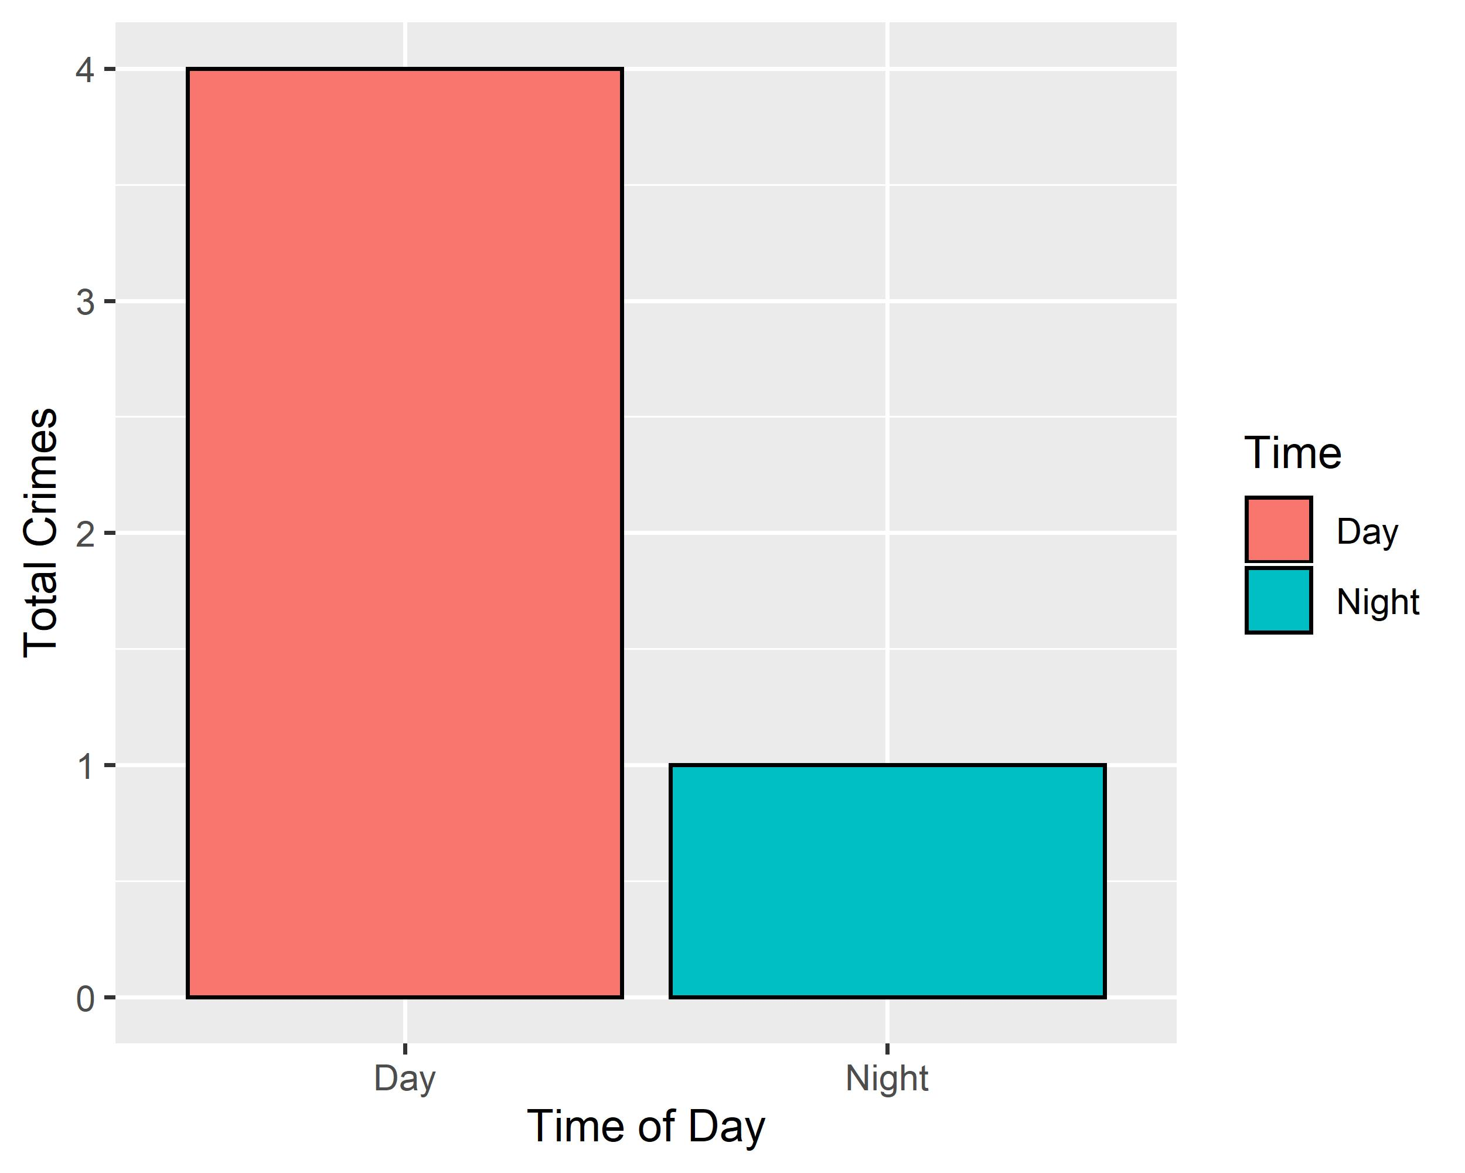
Visitation Park: Crimes by Time of Day

Slide 50
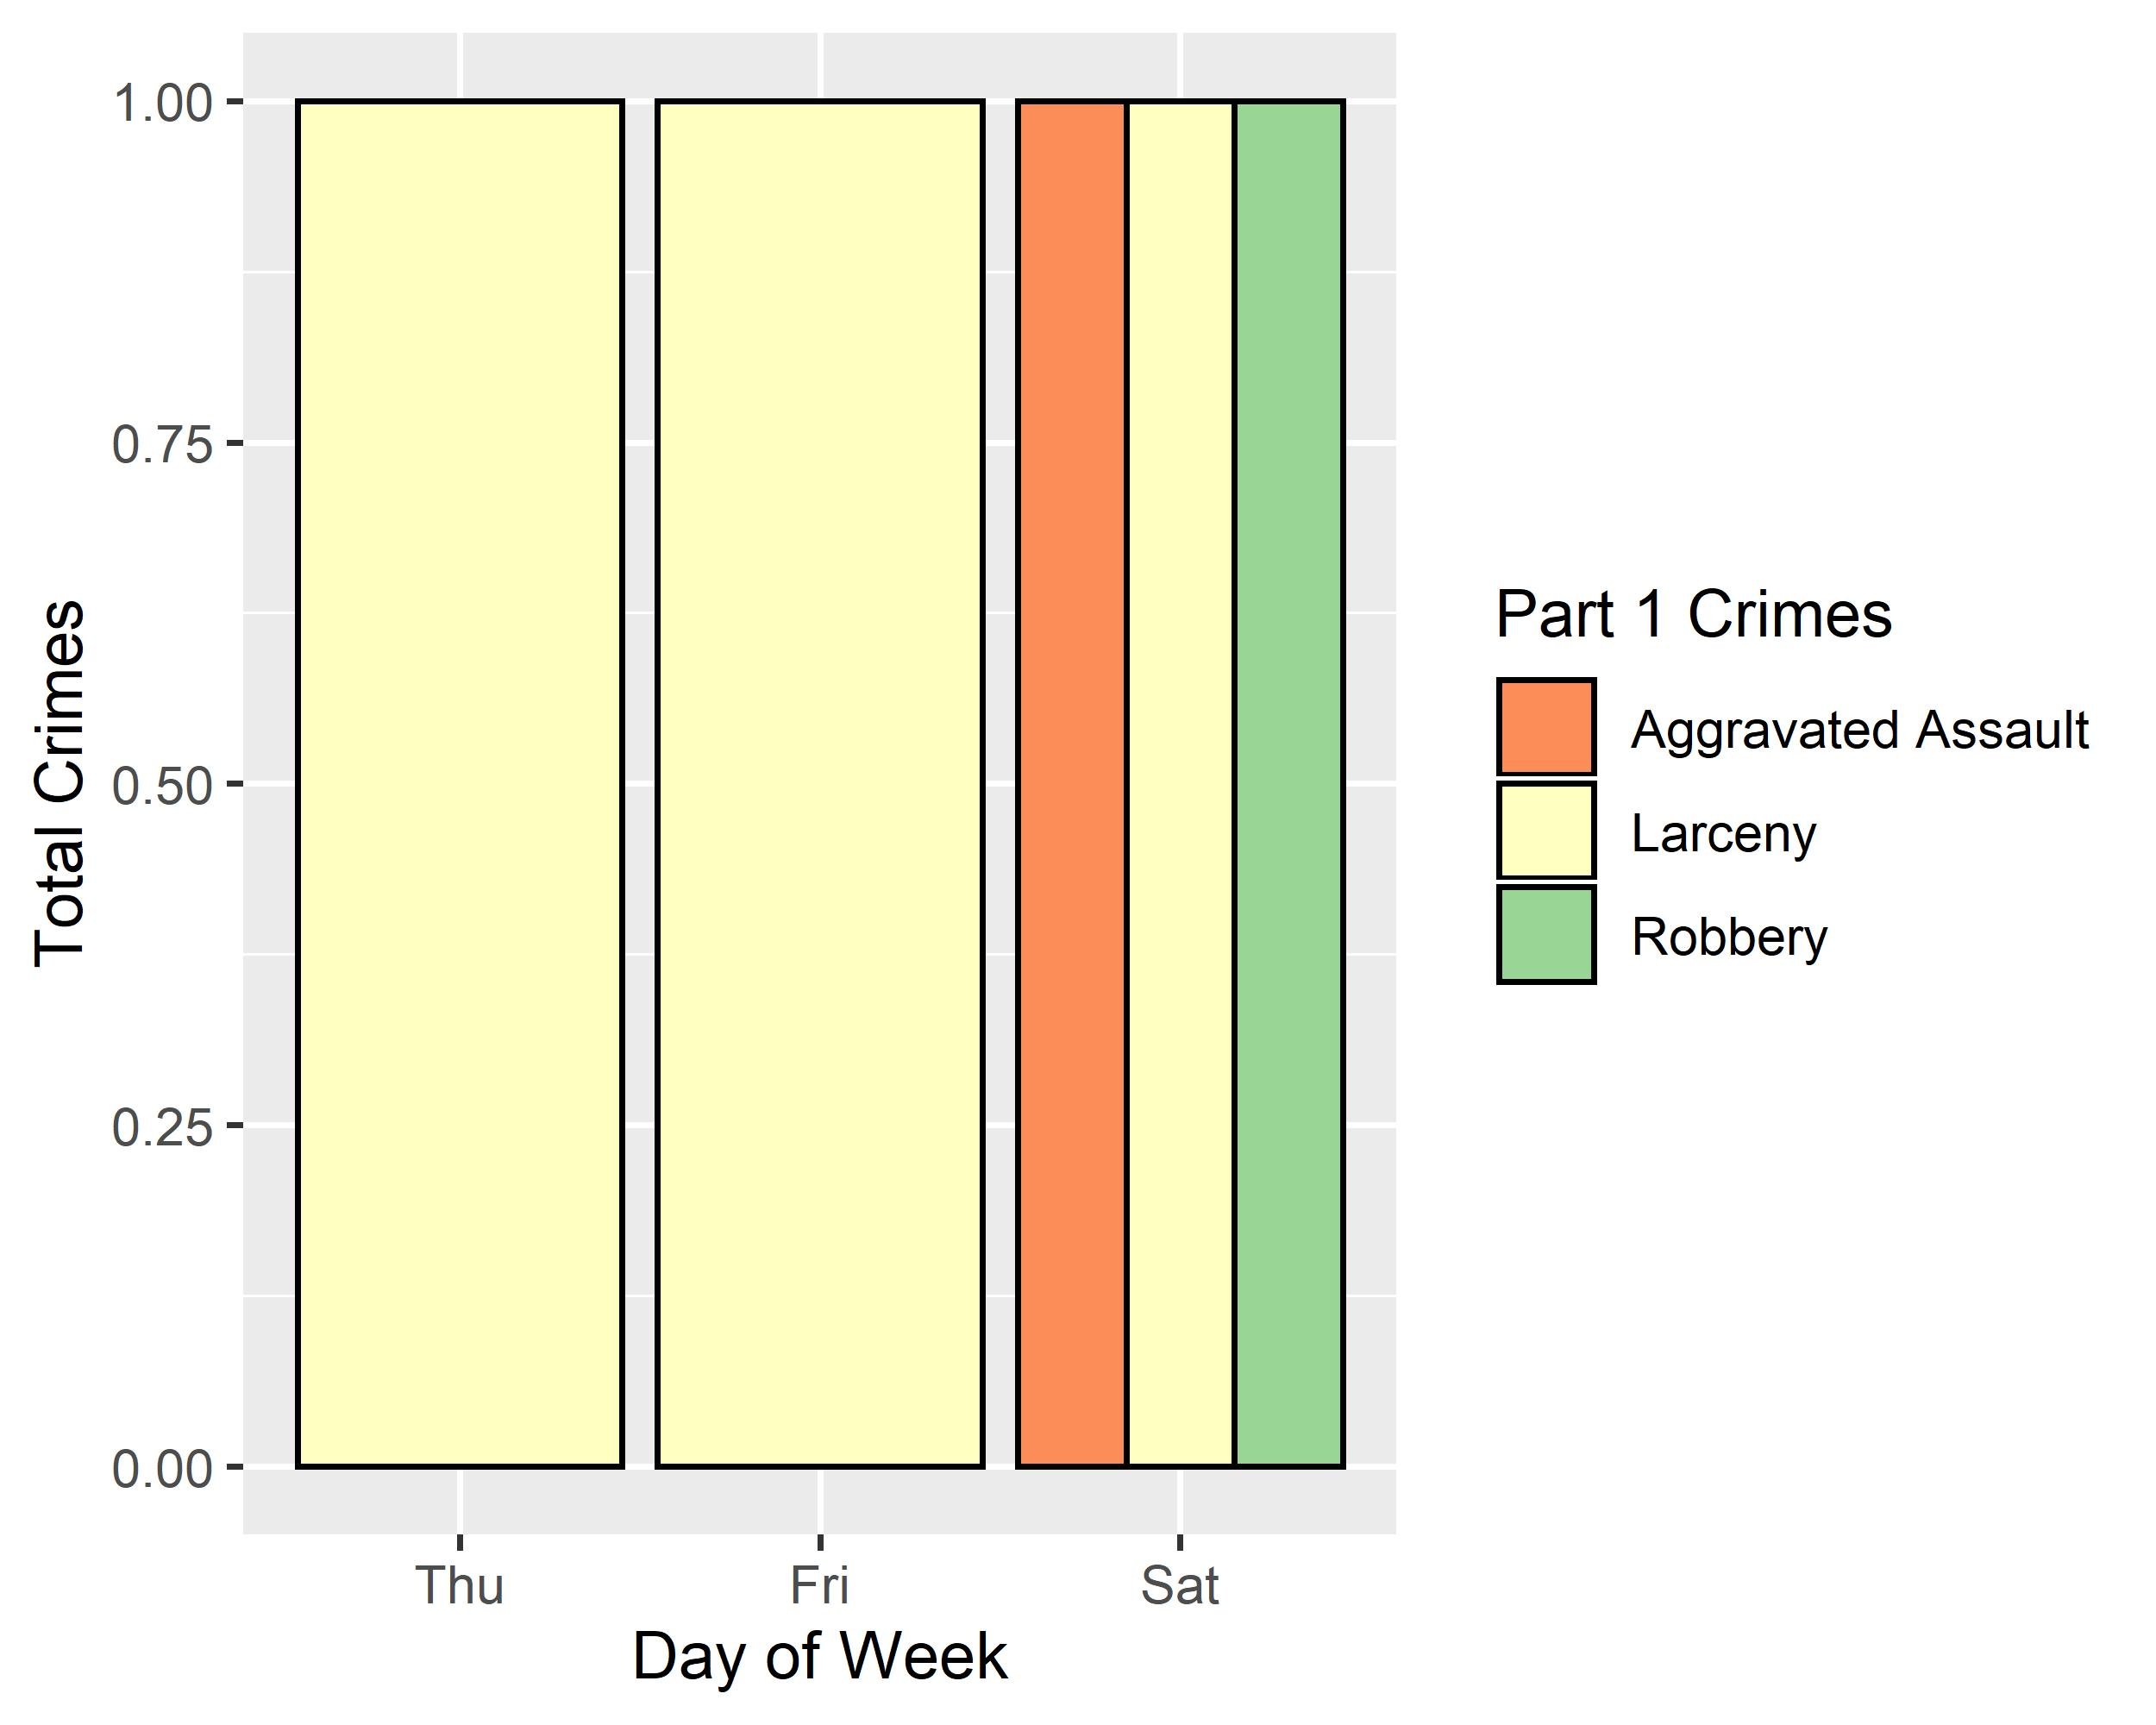
Visitation Park: Crimes by Day & Category

